Slide 1

Chapter 10
Application Layer
Data Communications and Networking, With TCP/IP protocol suite Sixth Edition
Behrouz A. Forouzan
© 2022 McGraw Hill, LLC. All rights reserved. Authorized only for instructor use in the classroom.
No reproduction or further distribution permitted without the prior written consent of McGraw Hill, LLC.

Slide 2
Chapter 10: Outline
10.1 Introduction
10.2 Client-Server Programming
10.3 Standard Applications
10.4 Peer-to-Peer Paradigm
10.5 Socket Interface Programming

Slide 3
10.1 INTRODUCTION
The application layer provides services to the user. Communication is provided using a logical connection, which means that the two application layers assume that there is an imaginary direct connection through which they can send and receive messages. Figure 10.1 shows the idea behind this logical connection.

Slide 4
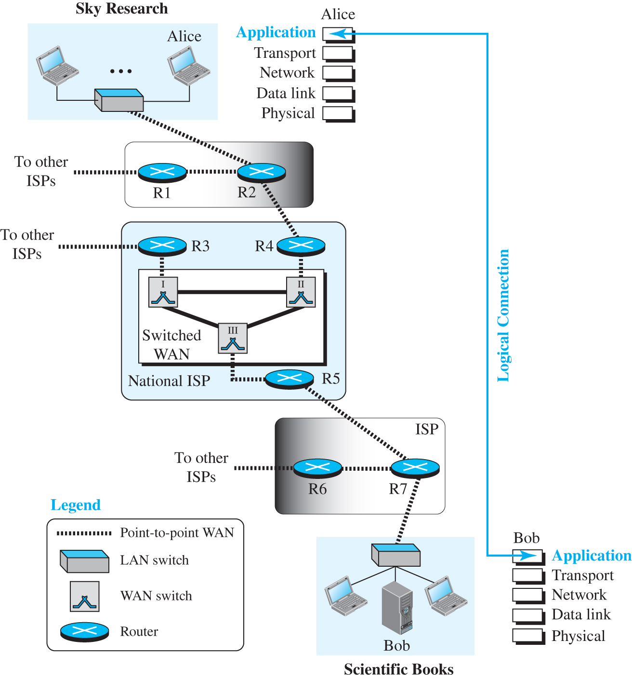
Figure 10.1 Logical connection at the application layer
Access the text alternative for slide images.

Slide 5
10.1.1 Providing Services
All communication networks that started before the Internet were designed to provide services to network users. Most of these networks, however, were originally designed to provide one specific service. For example, the telephone network was originally designed to provide voice service: to allow people all over the world to talk to each other. This network, however, was later used for some other services, such as facsimile (fax), enabled by users adding some extra hardware at both ends.

Slide 6
Standard and Nonstandard Protocols
To provide a smooth operation of the Internet, the protocols used in the first four layers of the TCP/IP suite need to be standardized and documented. They normally become part of the package that is included in operating systems such as Windows or UNIX. To be flexible, however, the application-layer protocols can be both standard and nonstandard.

Slide 7
10.1.2 Application-Layer Paradigms
It should be clear that to use the Internet we need two application programs to interact with each other: one running on a computer somewhere in the world, the other running on another computer somewhere else in the world. The two programs need to send messages to each other through the Internet infrastructure. However, we have not discussed what the relationship should be between these programs. Two paradigms have been developed: the client-server paradigm and the peer-to-peer paradigm. We briefly introduce these two paradigms here.

Slide 8
Traditional Paradigm: Client-Server
The traditional paradigm is called the client-server paradigm. It was the most popular paradigm until a few years ago. In this paradigm, the service provider is an application program, called the server process; it runs continuously, waiting for another application program, called the client process, to make a connection through the Internet and ask for service. There are normally some server processes that can provide a specific type of service, but there are many clients that request service from any of these server processes. The server process must be running all the time; the client process is started when the client needs to receive service.

Slide 9
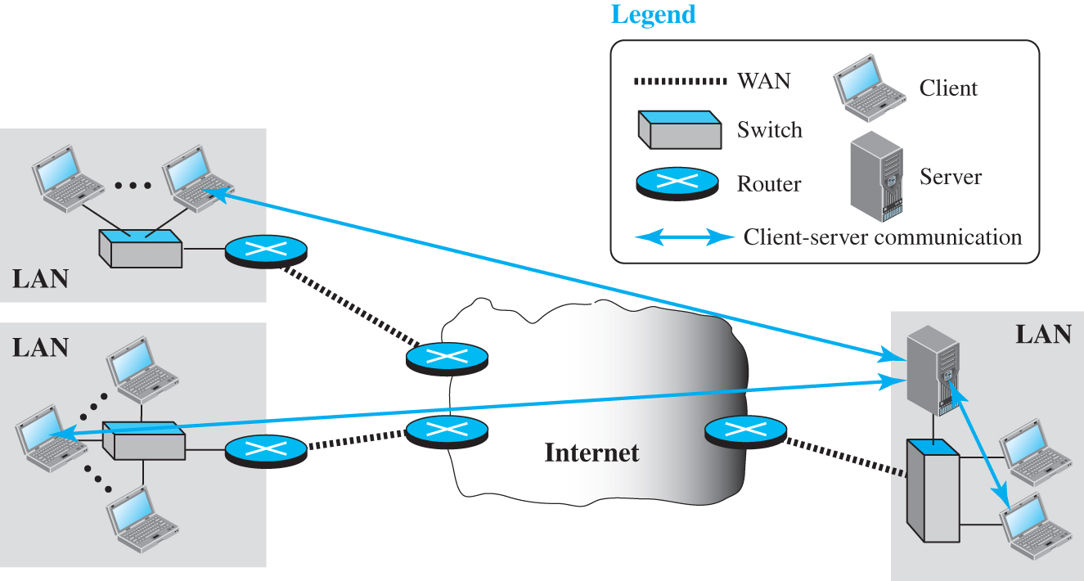
Figure 10.2 Example of a client-server paradigm
Access the text alternative for slide images.

Slide 10
New Paradigm: Peer-to-Peer
A new paradigm, called the peer-to-peer paradigm (often abbreviated P2P paradigm) has emerged to respond to the needs of some new applications. In this paradigm, there is no need for a server process to be running all the time and waiting for the client processes to connect. The responsibility is shared between peers. A computer connected to the Internet can provide service at one time and receive service at another time. A computer can even provide and receive services at the same time. Figure 10.3 shows an example of communication in this paradigm.

Slide 11
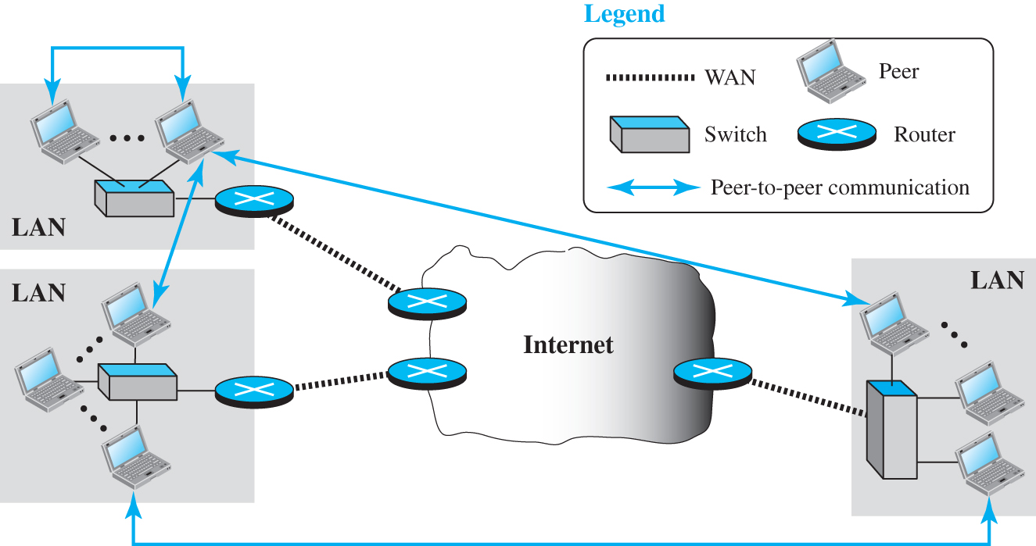
Figure 10.3 Example of a peer-to-peer paradigm
Access the text alternative for slide images.

Slide 12
Mixed Paradigm
An application may choose to use a mixture of the two paradigms by combining the advantages of both. For example, a light-load client-server communication can be used to find the address of the peer that can offer a service. When the address of the peer is found, the actual service can be received from the peer by using the peer-to-peer paradigm.

Slide 13
10.2 CLIENT-SERVER PROGRAMMING
In a client-server paradigm, communication at the application layer is between two running application programs called processes: a client and a server. A client is a running program that initializes the communication by sending a request; a server is another application program that waits for a request from a client. The server handles the request received from a client, prepares a result, and sends the result back to the client.

Slide 14
10.2.1 Application Programming Interface
How can a client process communicate with a server process? A computer program is normally written in a computer language with a predefined set of instructions that tells the computer what to do. If we need a process to be able to communicate with another process, we need a new set of instructions to tell the lowest four layers of the TCP/IP suite to open the connection, send and receive data from the other end, and close the connection. A set of instructions of this kind is normally referred to as an application programming interface (API).

Slide 15
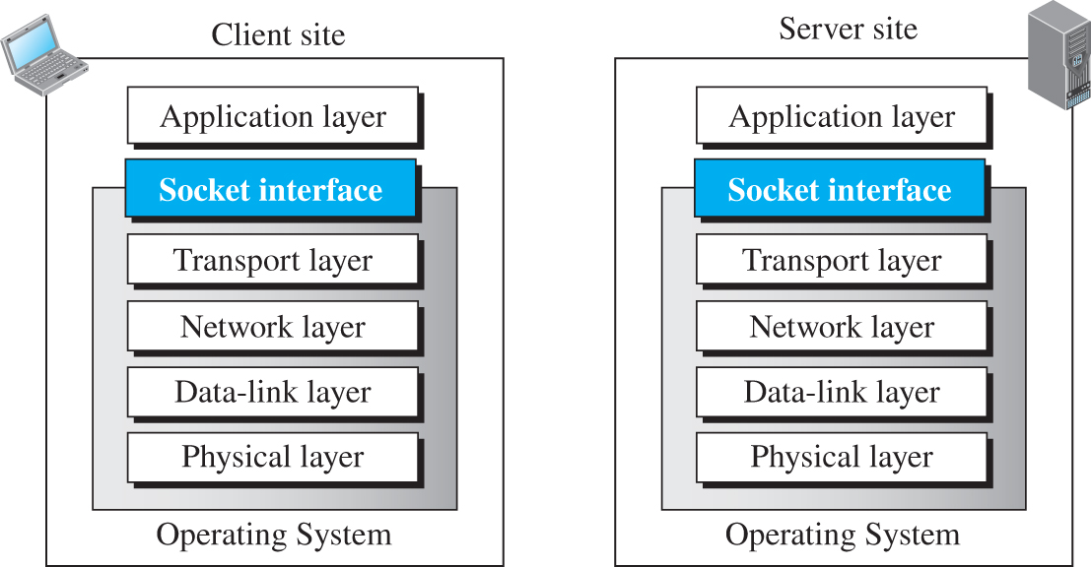
Figure 10.4 Position of the socket interface
Access the text alternative for slide images.

Slide 16
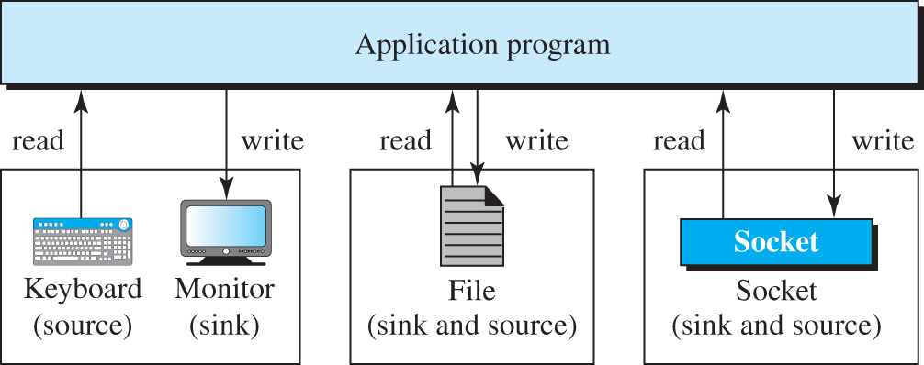
Figure 10.5 A sockets used like other sources and sinks
Access the text alternative for slide images.

Slide 17
Sockets
Although a socket is supposed to behave like a terminal or a file, it is not a physical entity like them; it is an abstraction. It is a data structure that is created and used by the application program.

Slide 18
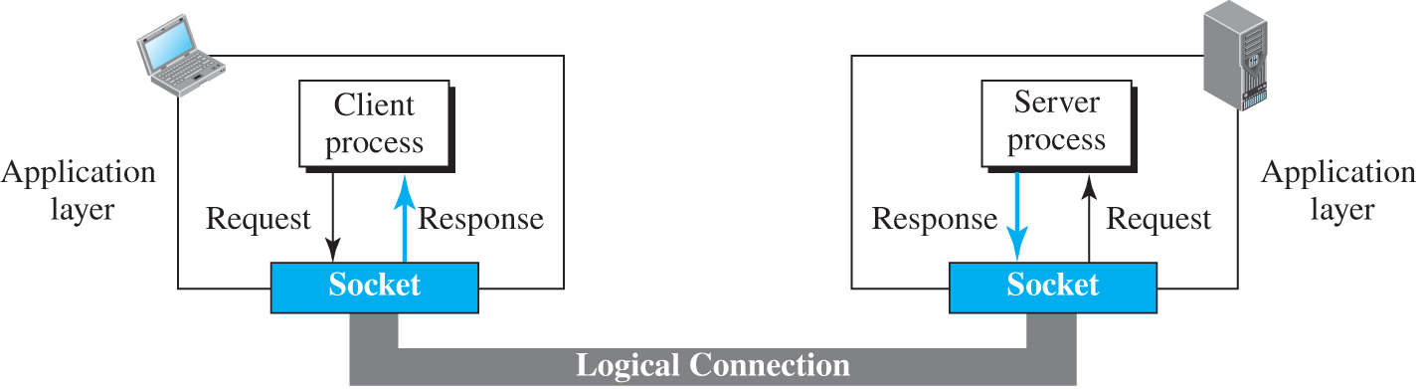
Figure 10.6 Use of sockets in process-to-process communication
Access the text alternative for slide images.

Slide 19
Socket Addresses
The interaction between a client and a server is two-way communication. In a two-way communication, we need a pair of addresses: local (sender) and remote (receiver). The local address in one direction is the remote address in the other direction and vice versa. Since communication in the client-server paradigm is between two sockets, we need a pair of socket addresses for communication: a local socket address and a remote socket address. However, we need to define a socket address in terms of identifiers used in the TCP/IP protocol suite.

Slide 20
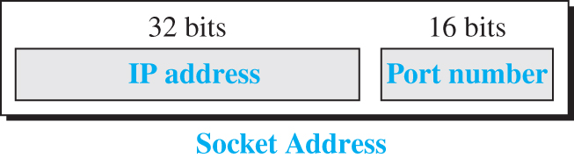
Figure 10.7 A socket address

Slide 21
Example 10.1
We can find a two-level address in telephone communication. A telephone number can define an organization, and an extension can define a specific connection in that organization. The telephone number in this case is similar to the IP address, which defines the whole organization; the extension is similar to the port number, which defines the particular connection.

Slide 22
Finding Socket Addresses
How can a client or a server find a pair of socket addresses for communication? The situation is different for each site.

Slide 23
10.2.2 Using Services of Transport Layer
A pair of processes provide services to the users of the Internet, human or programs. A pair of processes, however, need to use the services provided by the transport layer for communication because there is no physical communication at the application layer. As we discussed before, there are three common transport-layer protocols in the TCP/IP suite: UDP, TCP, and SCTP. Most standard applications have been designed to use the services of one of these protocols.

Slide 24
UDP Protocol
UDP provides connectionless, unreliable, datagram service. Connectionless service means that there is no logical connection between the two ends exchanging messages. Each message is an independent entity encapsulated in a packet called a datagram. UDP does not see any relation (connection) between consequent datagrams coming from the same source and going to the same destination.

Slide 25
TCP Protocol
TCP provides connection-oriented, reliable, byte-stream service. TCP requires that two ends first create a logical connection between themselves by exchanging some connection-establishment packets. This phase, which is sometimes called handshaking, establishes some parameters between the two ends including the size of the data packets to be exchanged, the size of buffers to be used for holding the chunks of data until the whole message arrives, and so on.

Slide 26
SCTP Protocol
SCTP provides a service that is a combination of the two other protocols. Like TCP, SCTP provides a connection-oriented, reliable service, but it is not byte-stream oriented. It is a message-oriented protocol like UDP. In addition, SCTP can provide multi-stream service by providing multiple network-layer connections.

Slide 27
10-3 STANDARD APPLICATIONS
During the lifetime of the Internet, several client-server application programs have been developed. We do not have to redefine them, but we need to understand what they do. For each application, we also need to know the options available to us. The study of these applications and the ways they provide different services can help us to create customized applications in the future.

Slide 28
10.3.1 World Wide Web and HTTP
In this section, we first introduce the World Wide Web (abbreviated WWW or Web). We then discuss the HyperText Transfer Protocol (HTTP), the most common client-server application program used in relation to the Web.

Slide 29
World Wide Web
The idea of the Web was first proposed by Tim Berners-Lee in 1989 at CERN, the European Organization for Nuclear Research, to allow several researchers at different locations throughout Europe to access each others’ researches. The commercial Web started in the early 1990s.

Slide 30
Example 10.2
Assume we need to retrieve a scientific document that contains one reference to another text file and one reference to a large image. Figure 10.8 shows the situation.

Slide 31
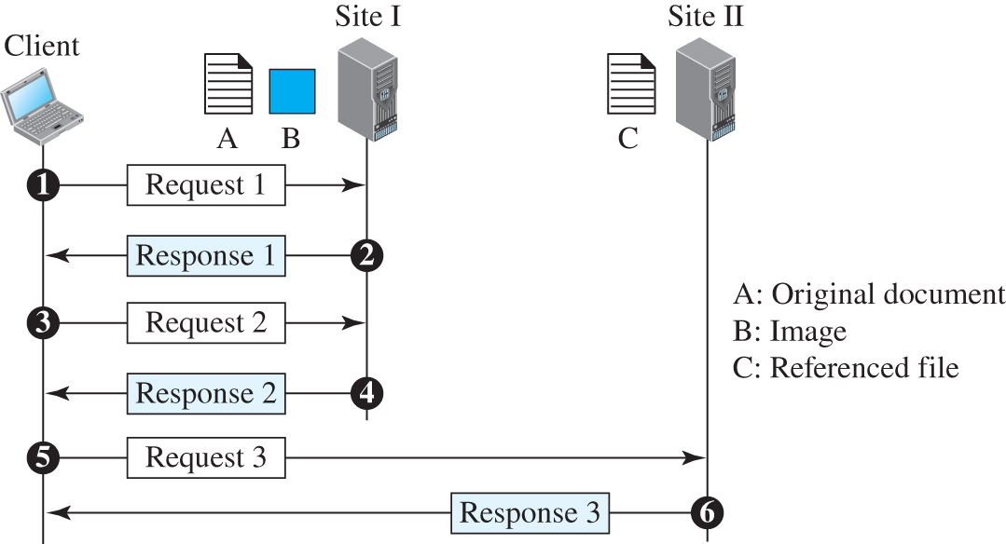
Figure 10.8 Example 10.2
Access the text alternative for slide images.

Slide 32
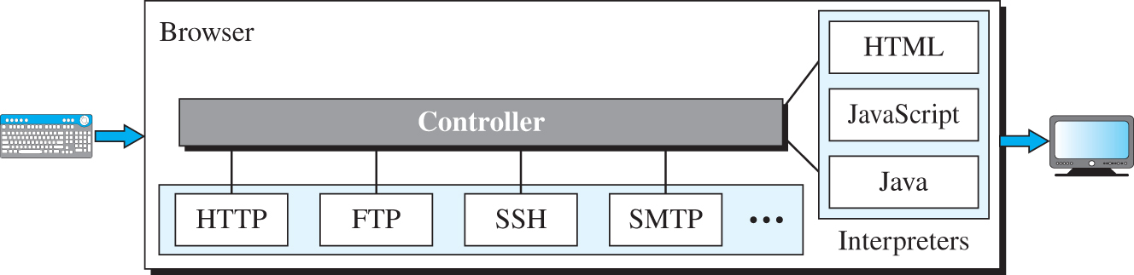
Figure 10.9 Browser
Access the text alternative for slide images.

Slide 33
Example 10.3
The URL http://www.mhhe.com/compsci/forouzan/ defines the web page related to one of the computers in the McGraw-Hill company (the three letters www are part of the host name and are added to the commercial host). The path is compsci/forouzan/, which defines Forouzan’s web page under the directory compsci (computer science).

Slide 34
HyperText Transfer Protocol (HTTP)
The HyperText Transfer Protocol (HTTP) is a protocol that is used to define how the client-server programs can be written to retrieve web pages from the Web. An HTTP client sends a request; an HTTP server returns a response. The server uses the port number 80; the client uses a temporary port number.

Slide 35
Example 10.4
Figure 10.10 shows an example of a nonpersistent connection. The client needs to access a file that contains one link to an image. The text file and image are located on the same server. Here we need two connections. For each connection, TCP requires at least three handshake messages to establish the connection, but the request can be sent with the third one. After the connection is established, the object can be transferred. After receiving an object, another three handshake messages are needed to terminate the connection.

Slide 36
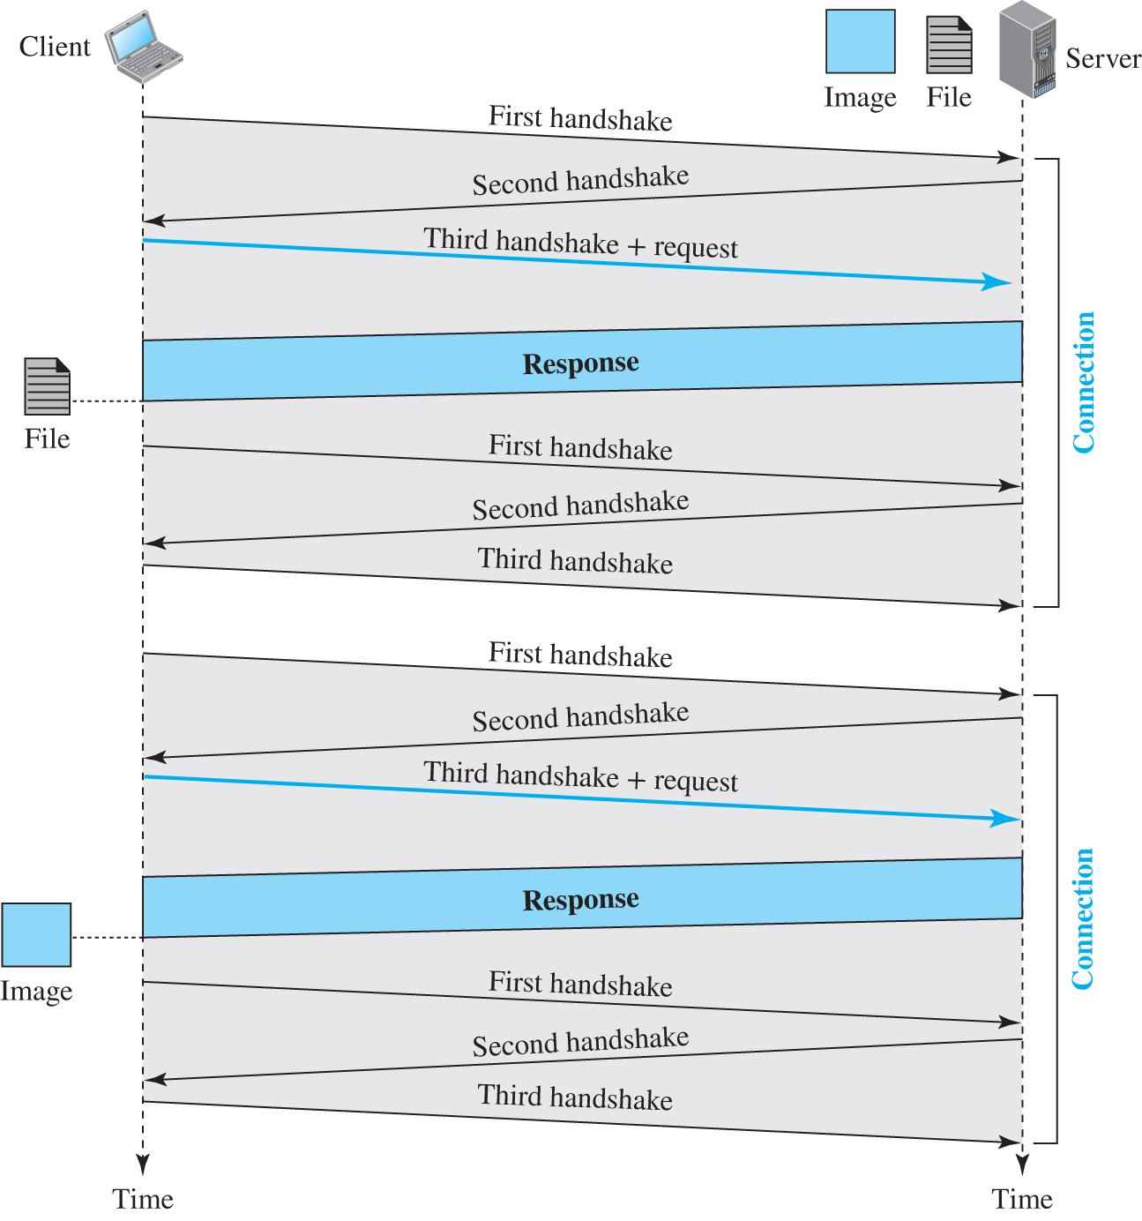
Figure 10.10 Example 10.4
Access the text alternative for slide images.

Slide 37
Example 10.5
Figure 10.11 shows the same scenario as in Example 10.4, but using a persistent connection. Only one connection establishment and connection termination is used, but the request for the image is sent separately.

Slide 38
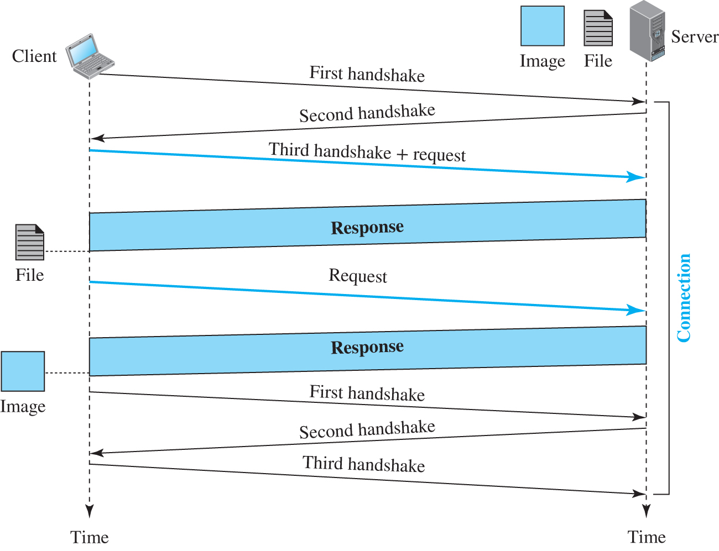
Figure 10.11 Example 10.5
Access the text alternative for slide images.

Slide 39
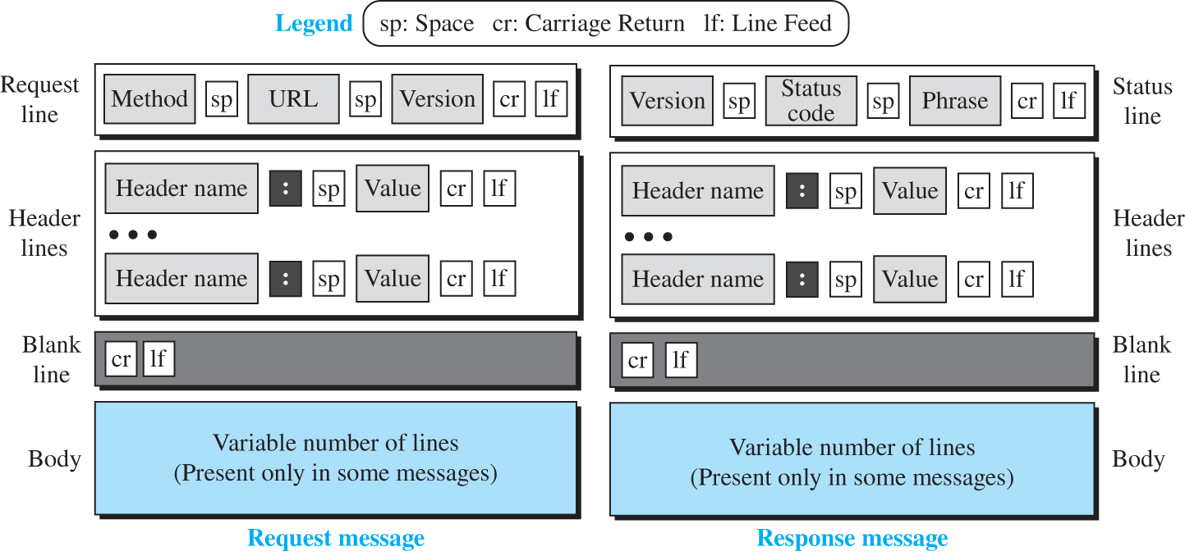
Figure 10.12 Formats of the request and response messages
Access the text alternative for slide images.

Slide 40
Table 10.1 Methods
Method | Action
GET | Requests a document from the server
HEAD | Requests information about a document but not the document itself
PUT | Sends a document from the client to the server
POST | Sends some information from the client to the server
TRACE | Echoes the incoming request
DELETE | Removes the web page
CONNECT | Reserved
OPTIONS | Inquires about available options

Slide 41
Table 10.2 Request header names
Header | Description
User-agent | Identifies the client program
Accept | Shows the media format the client can accept
Accept-charset | Shows the character set the client can handle
Accept-encoding | Shows the encoding scheme the client can handle
Accept-language | Shows the language the client can accept
Authorization | Shows what permissions the client has
Host | Shows the host and port number of the client
Date | Shows the current date
Upgrade | Specifies the preferred communication protocol
Cookie | Returns the cookie to the server (explained later in this section)
If-Modified-Since | Specifies if the file has been modified since a specific date

Slide 42
Table 10.3 Response header names
Header | Description
Date | Shows the current date
Upgrade | Specifies the preferred communication protocol
Server | Gives information about the server
Set-Cookie | The server asks the client to save a cookie
Content-Encoding | Specifies the encoding scheme
Content-Language | Specifies the language
Content-Length | Shows the length of the document
Content-Type | Specifies the media type
Location | To ask the client to send the request to another site
Accept-Ranges | The server will accept the requested byte-ranges
Last-modified | Gives the date and time of the last change

Slide 43
Example 10.6
This example retrieves a document (see Figure 10.13). We use the GET method to retrieve an image with the path /usr/bin/image1. The request line shows the method (GET), the URL, and the HTTP version (1.1). The header has two lines that show that the client can accept images in the GIF or JPEG format. The request does not have a body. The response message contains the status line and four lines of header. The header lines define the date, server, content encoding (MIME version, which will be described in electronic mail), and length of the document. The body of the document follows the header.

Slide 44
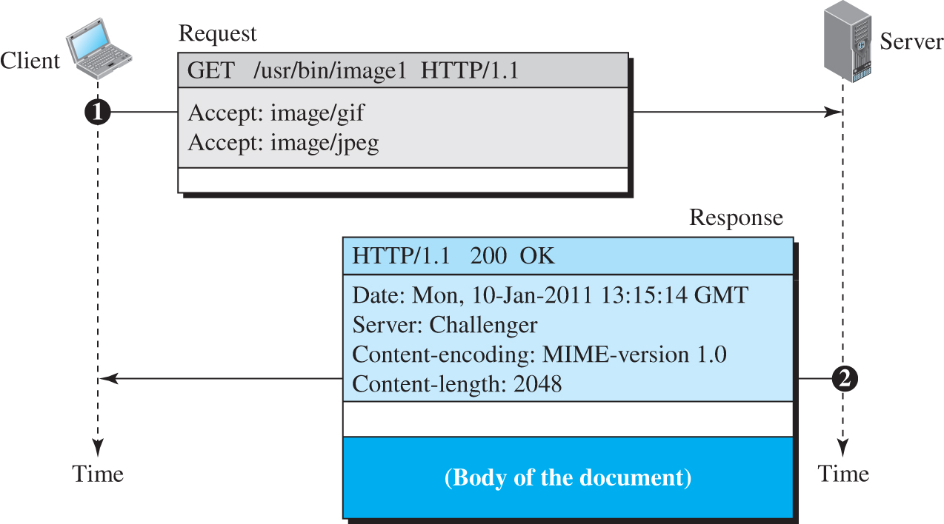
Figure 10.13 Example 10.6
Access the text alternative for slide images.

Slide 45
Example 10.7
In this example, the client wants to send a web page to be posted on the server. We use the PUT method. The request line shows the method (PUT), URL, and HTTP version (1.1). There are four lines of headers. The request body contains the web page to be posted. The response message contains the status line and four lines of headers. The created document, which is a CGI document, is included as the body (see Figure 10.14).

Slide 46
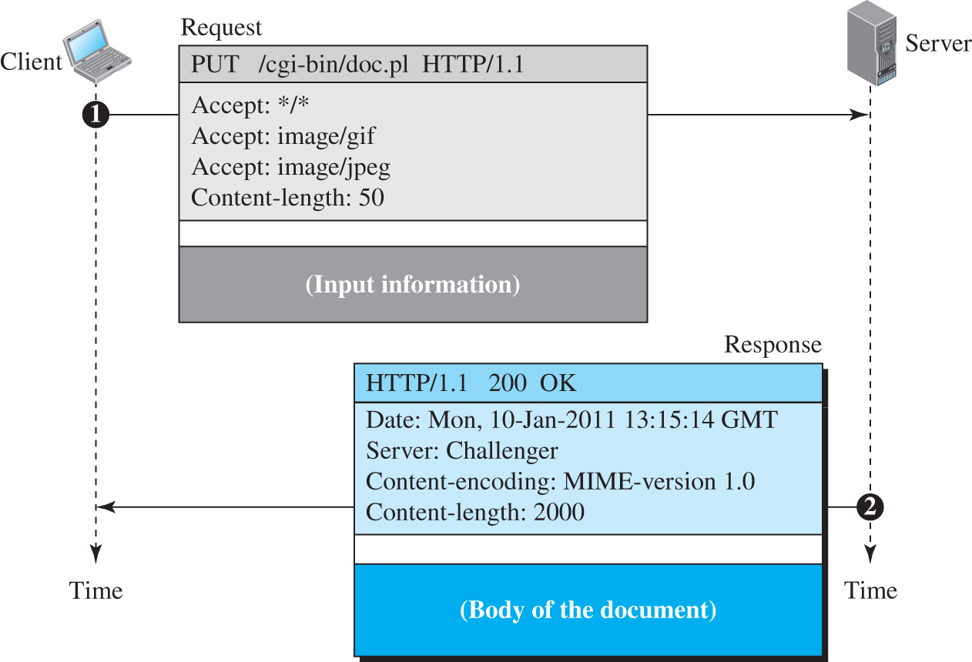
Figure 10.14 Example 10.7
Access the text alternative for slide images.

Slide 47
Example 10.8
The following shows how a client imposes the modification data and time condition on a request.
GET http://www.commonServer.com/information/file1 HTTP/1.1 | Request line
If-Modified-Since: Thu, Sept 04 00:00:00 GMT | Header line
 | Blank line
The status line in the response shows the file was not modified after the defined point in time. The body of the response message is also empty.
HTTP/1.1 304 Not Modified | Status line
Date: Sat, Sept 06 08 16:22:46 GMT | First header line
Server: commonServer.com | Second header line
 | Blank line
(Empty Body) | Empty body

Slide 48
Example 10.9
Figure 10.15 shows a scenario in which an electronic store can benefit from the use of cookies. Assume a shopper wants to buy a toy from an electronic store named BestToys. The shopper browser (client) sends a request to the BestToys server. The server creates an empty shopping cart (a list) for the client and assigns an ID to the cart (for example, 12343). The server then sends a response message, which contains the images of all toys available, with a link under each toy that selects the toy if it is being clicked. This response message also includes the Set-Cookie header line whose value is 12343. The client displays the images and stores the cookie value in a file named BestToys.

Slide 49
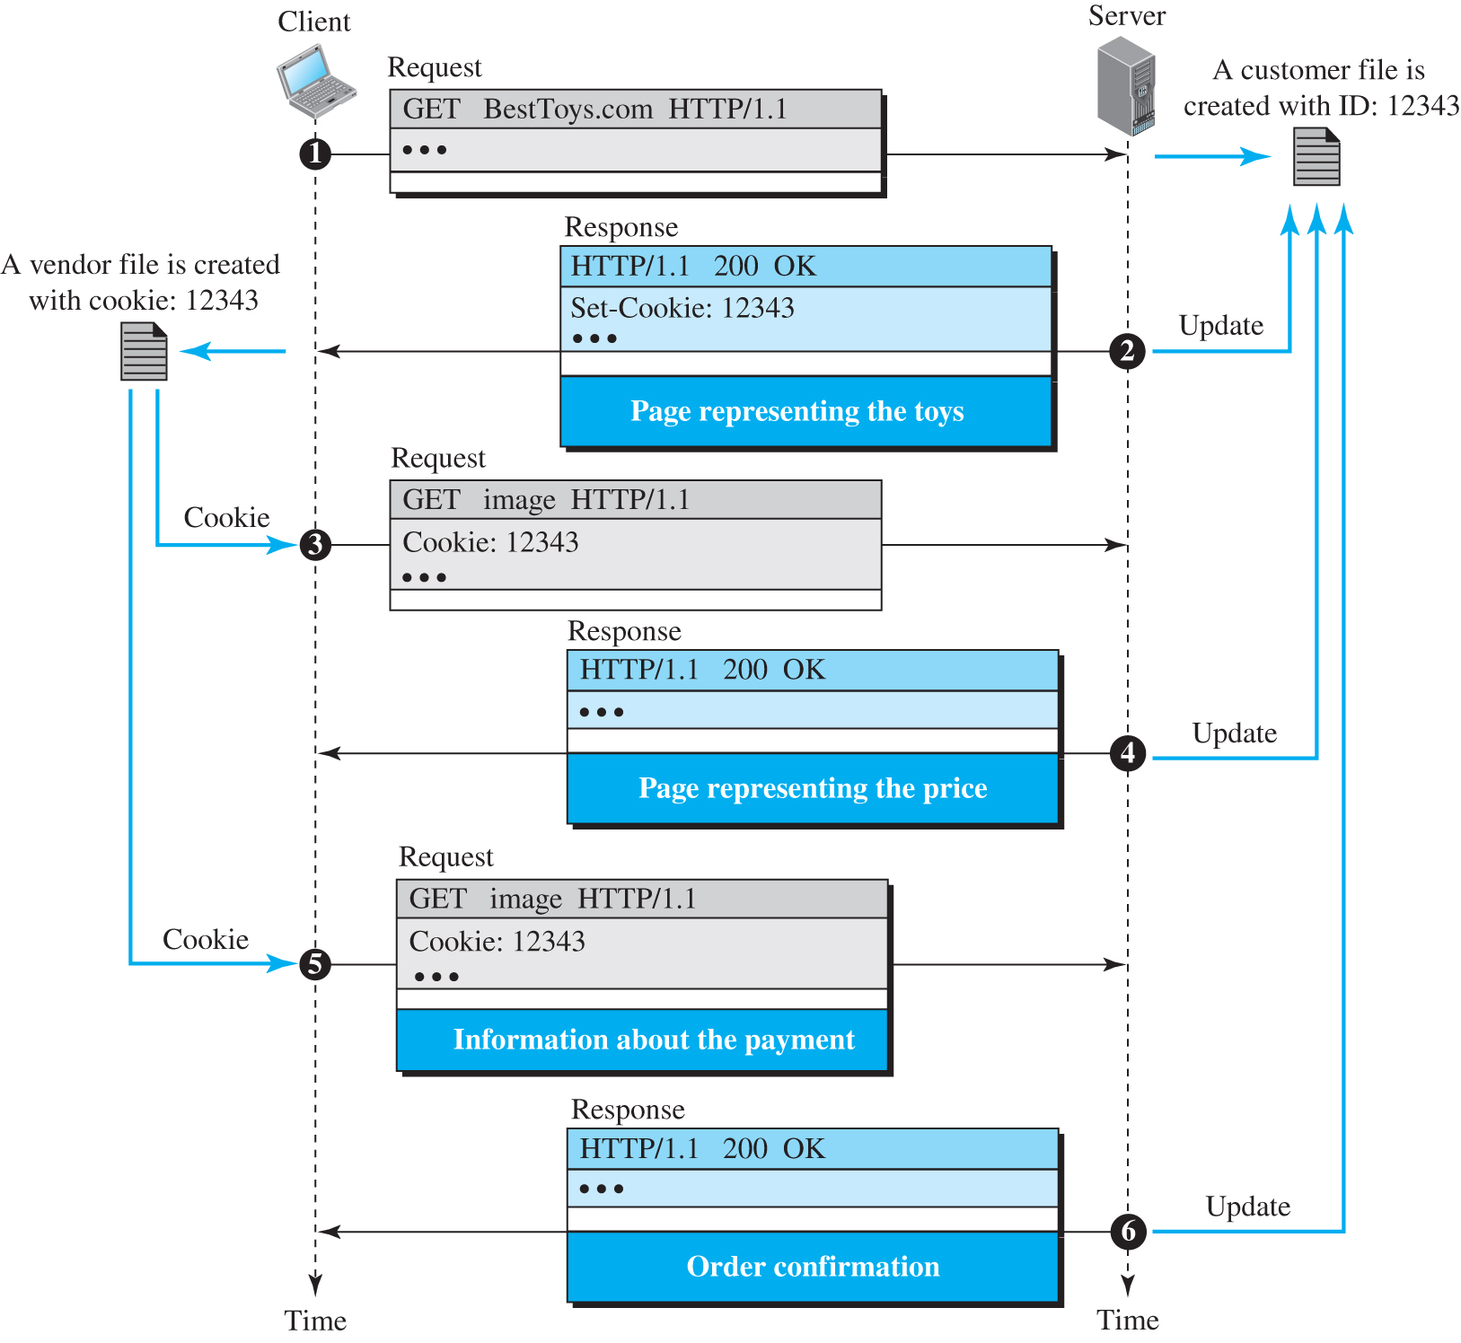
Figure 10.15 Example 10.9
Access the text alternative for slide images.

Slide 50
Example 10.10
Figure 10.16 shows an example of a use of a proxy server in a local network, such as the network on a campus or in a company. The proxy server is installed in the local network. When an HTTP request is created by any of the clients (browsers), the request is first directed to the proxy server If the proxy server already has the corresponding web page, it sends the response to the client. Otherwise, the proxy server acts as a client and sends the request to the web server in the Internet. When the response is returned, the proxy server makes a copy and stores it in its cache before sending it to the requesting client.

Slide 51
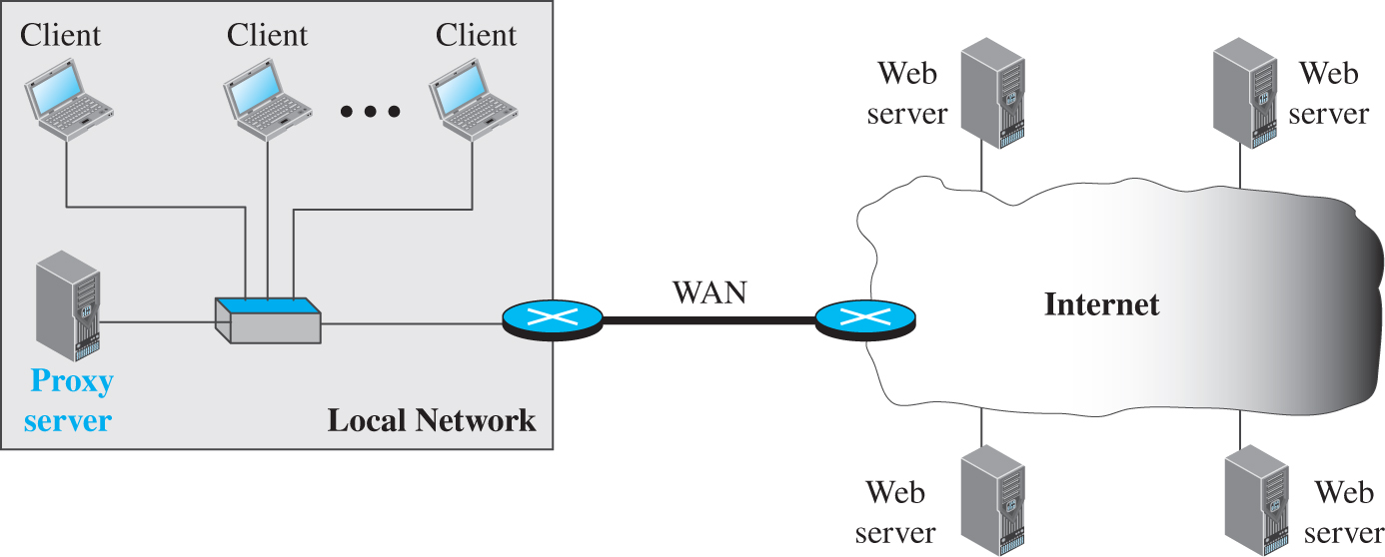
Figure 10.16 Example of a proxy server
Access the text alternative for slide images.

Slide 52
HTTP Security
HTTP per se does not provide security. However, HTTP can be run over the Secure Socket Layer (SSL). In this case, HTTP is referred to as HTTPS. HTTPS provides confidentiality, client and server authentication, and data integrity.

Slide 53
10.3.2 FTP
File Transfer Protocol (FTP) is the standard protocol provided by TCP/IP for copying a file from one host to another. Although transferring files from one system to another seems simple and straightforward, some problems must be dealt with first. For example, two systems may use different file name conventions. Two systems may have different ways to represent data. Two systems may have different directory structures. All of these problems have been solved by FTP in a very simple and elegant approach. Although we can transfer files using HTTP, FTP is a better choice to transfer large files or to transfer files using different formats.

Slide 54
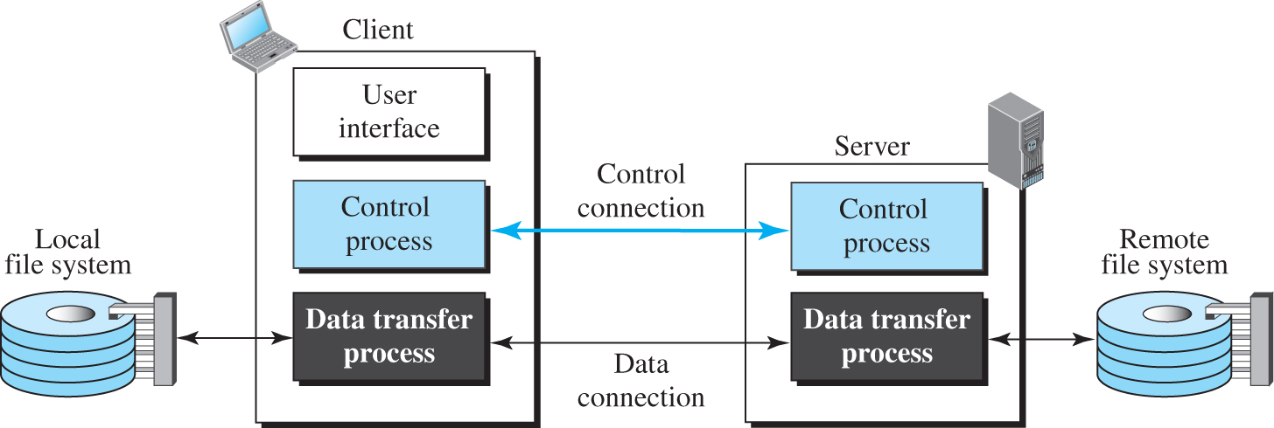
Figure 10.17 FTP
Access the text alternative for slide images.

Slide 55
Lifetimes of Two Connections
The two connections in FTP have different lifetimes. The control connection remains connected during the entire interactive FTP session. The data connection is opened and then closed for each file transfer activity. It opens each time commands that involve transferring files are used, and it closes when the file is transferred. In other words, when a user starts an FTP session, the control connection opens. While the control connection is open, the data connection can be opened and closed multiple times if several files are transferred. FTP uses two well-known TCP ports: port 21 is used for the control connection, and port 20 is used for the data connection.

Slide 56
Control Connection
For control communication, FTP uses the same approach as TELNET (discussed later). It uses the NVT ASCII character set as used by TELNET. Communication is achieved through commands and responses. This simple method is adequate for the control connection because we send one command (or response) at a time. Each line is terminated with a two-character (carriage return and line feed) end-of-line token.

Slide 57
Table 10.4 Some FTP commands 1
Command | Argument(s) | Description
ABOR |  | Abort the previous command
CDUP |  | Change to parent directory
CWD | Directory name | Change to another directory
DELE | File name | Delete a file
LIST | Directory name | List subdirectories or files
MKD | Directory name | Create a new directory
PASS | User password | Password
PASV |  | Server chooses a port
PORT | port identifier | Client chooses a port
PWD |  | Display name of current directory
QUIT |  | Log out of the system
RETR | File name(s) | Retrieve files; files are transferred from server to client
RMD | Directory name | Delete a directory
RNFR | File name (old) | Identify a file to be renamed

Slide 58
Table 10.4 Some FTP commands 2
Command | Argument(s) | Description
RNTO | File name (new) | Rename the file
STOR | File name(s) | Store files; file(s) are transferred from client to server
STRU | F, R, or P | Define data organization (F: file, R: record, or P: page)
TYPE | A, E, I | Default file type (A: ASCII, E: EBCDIC, I: image)
USER | User ID | User information
MODE | S, B, or C | Define transmission mode (S: stream, B: block, or C: compressed)

Slide 59
Table 10.5 Some responses in FTP
Code | Description | Code | Description
125 | Data connection open | 250 | Request file action OK
150 | File status OK | 331 | User name OK; password is needed
200 | Command OK | 425 | Cannot open data connection
220 | Service ready | 450 | File action not taken; file not available
221 | Service closing | 452 | Action aborted; insufficient storage
225 | Data connection open | 500 | Syntax error; unrecognized command
226 | Closing data connection | 501 | Syntax error in parameters or arguments
230 | User login OK | 530 | User not logged in

Slide 60
Data Connection
The data connection uses the well-known port 20 at the server site. However, the creation of a data connection is different from the control connection. The following shows the steps:
The client, not the server, issues a passive open using an ephemeral port.
Using the PORT command the client sends the port number to the server..
The server receives the port number and issues an active open using the well-known port 20 and the received ephemeral port number.

Slide 61
Example 10.11
Figure 10.18 shows an example of using FTP for retrieving a file. The figure shows only one file to be transferred. The control connection remains open all the time, but the data connection is opened and closed repeatedly. We assume the file is transferred in six sections. After all records have been transferred, the server control process announces that the file transfer is done. Since the client control process has no file to retrieve, it issues the QUIT command, which causes the service connection to be closed.

Slide 62
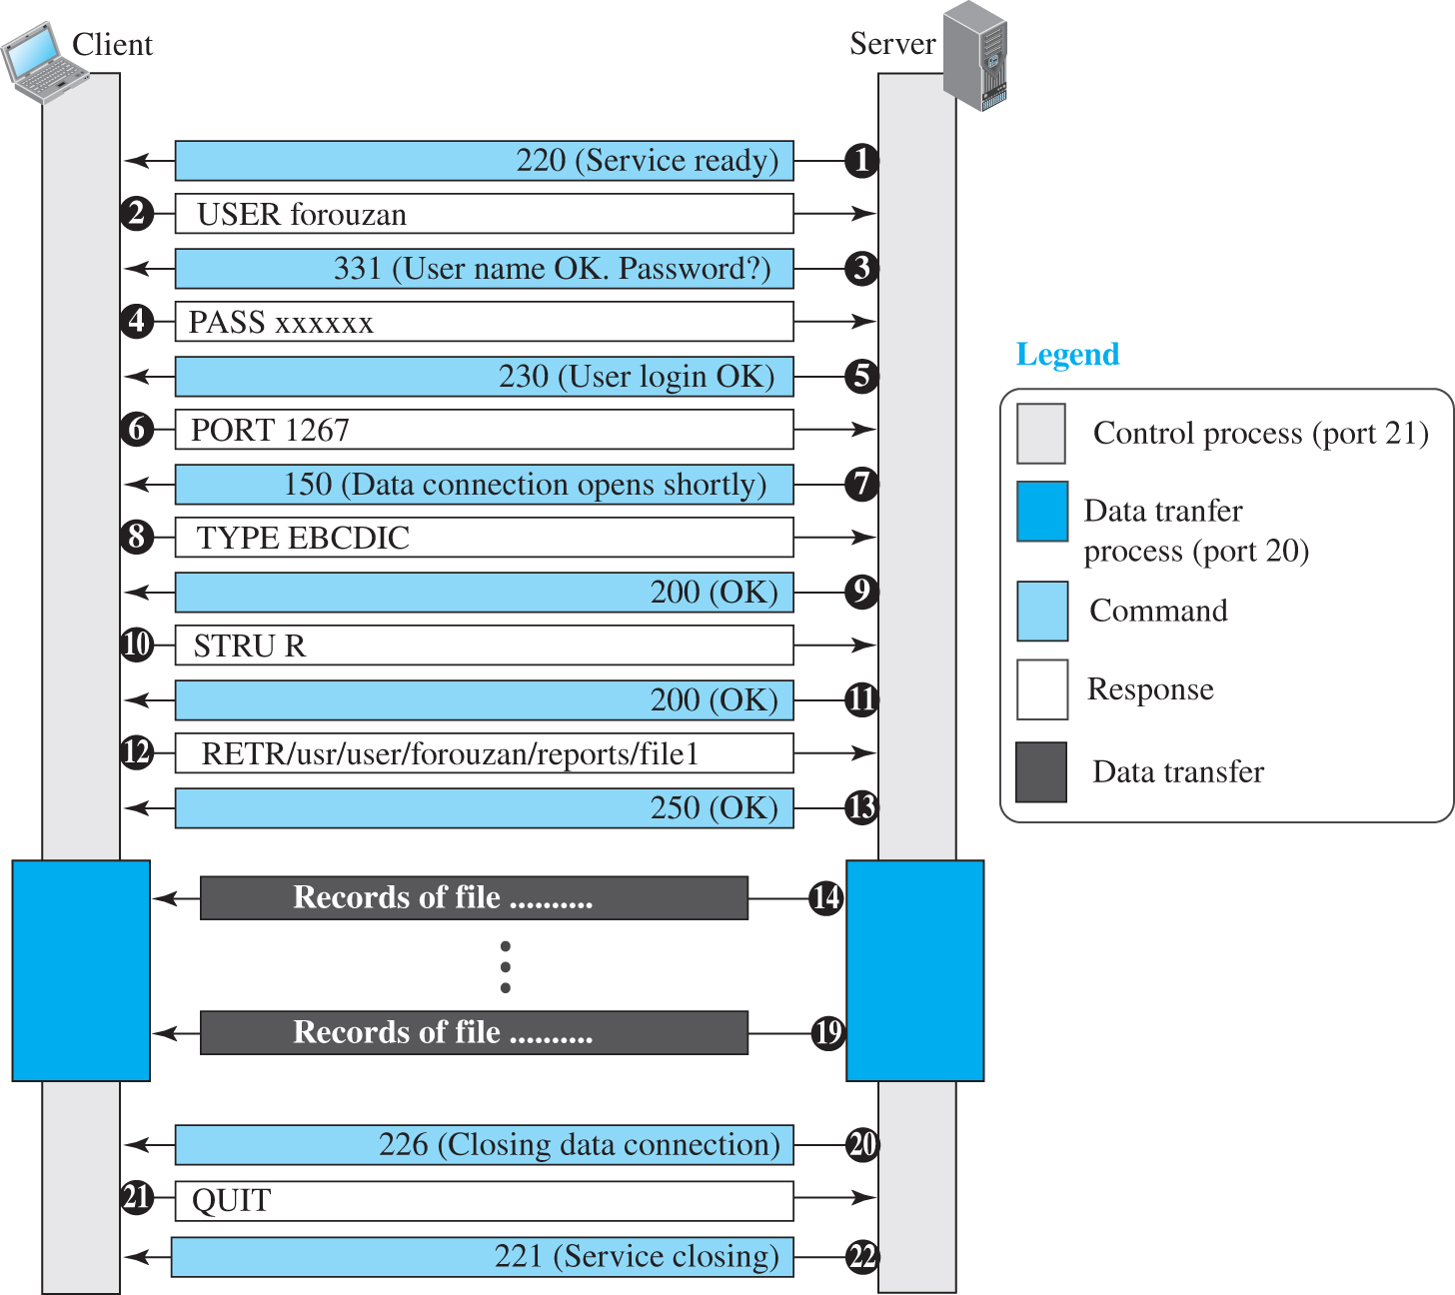
Figure 10.18 Example 10.11
Access the text alternative for slide images.

Slide 63
Example 10.12
The following shows an actual FTP session that lists the directories.
$ ftp voyager.deanza.fhda.edu
Connected to voyager.deanza.fhda.edu.
220 (vsFTPd 1.2.1)
530 Please login with USER and PASS.
Name (voyager.deanza.fhda.edu:forouzan): forouzan
331 Please specify the password.
Password:*********
230 Login successful.
Remote system type is UNIX.
Using binary mode to transfer files.
227 Entering Passive Mode (153,18,17,11,238,169)
150 Here comes the directory listing.
drwxr-xr-x 2 3027 411 4096 Sep 24 2002 business
drwxr-xr-x 2 3027 411 4096 Sep 24 2002 personal
drwxr-xr-x 2 3027 411 4096 Sep 24 2002 school
226 Directory send OK.
ftp> quit
221 Goodbye.

Slide 64
Security for FTP
The FTP protocol was designed when security was not a big issue. Although FTP requires a password, the password is sent in plaintext (unencrypted), which means it can be intercepted and used by an attacker. The data transfer connection also transfers data in plaintext, which is insecure. To be secure, one can add a Secure Socket Layer between the FTP application layer and the TCP layer. In this case FTP is called SSL-FTP. We also explore some secure file transfer applications when we discuss SSH later in the chapter.

Slide 65
10.3.3 Electronic Mail
Electronic mail (or e-mail) allows users to exchange messages. The nature of this application, however, is different from other applications discussed so far. In an application such as HTTP or FTP, the server program is running all the time, waiting for a request from a client. When the request arrives, the server provides the service. There is a request and there is a response. In the case of electronic mail, the situation is different. First, e-mail is considered a one-way transaction. When Alice sends an e-mail to Bob, she may expect a response, but this is not a mandate.

Slide 66
Architecture
To explain the architecture of e-mail, we give a common scenario, as shown in Figure 10.19. Another possibility is the case in which Alice or Bob is directly connected to the corresponding mail server, in which LAN or WAN connection is not required, but this variation in the scenario does not affect our discussion.

Slide 67
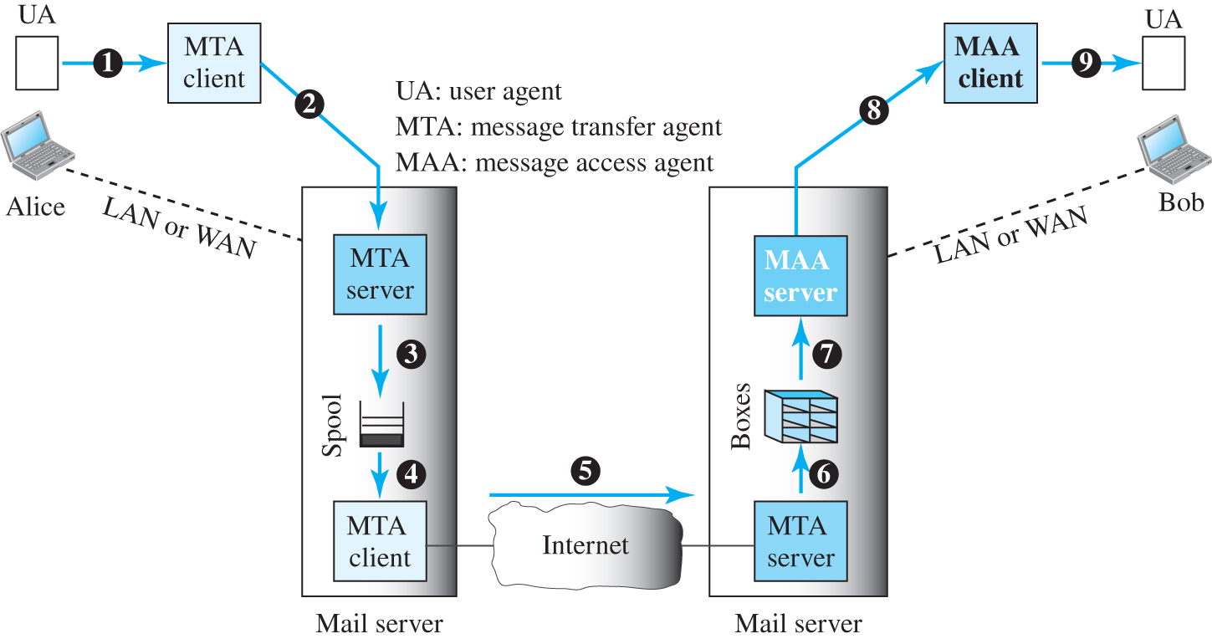
Figure 10.19 Common scenario

Slide 68
User Agent
The first component of an electronic mail system is the user agent (UA). It provides service to the user to make the process of sending and receiving a message easier. A user agent is a software package (program) that composes, reads, replies to, and forwards messages. It also handles local mailboxes on the user computers.

Slide 69
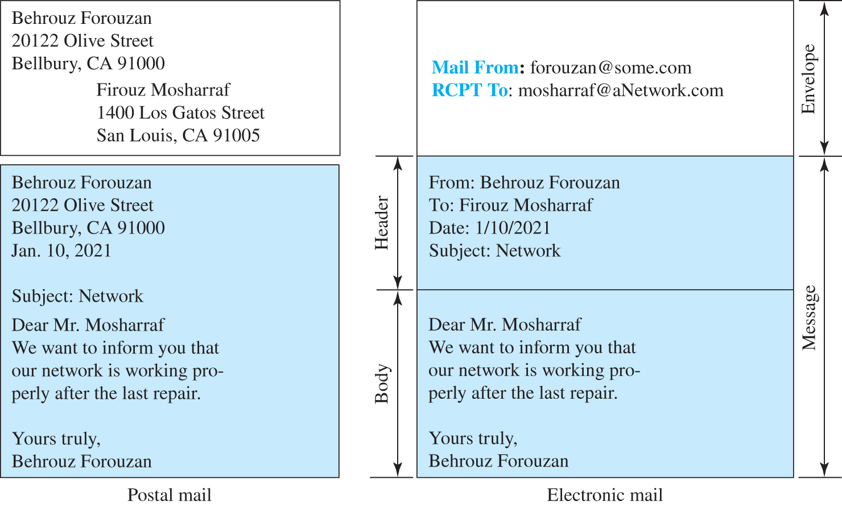
Figure 10.20 Format of an e-mail

Slide 70
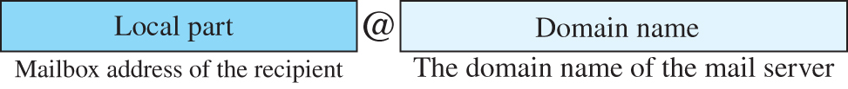
Figure 10.21 E-mail address
Access the text alternative for slide images.

Slide 71
Message Transfer Agent: SMTP
Based on the common scenario (Figure 10.19), we can say that the e-mail is one of those applications that needs three uses of client-server paradigms to accomplish its task. It is important that we distinguish these three when we are dealing with e-mail. Figure 10.22 shows these three client-server applications. We refer to the first and the second as Message Transfer Agents (MTAs), the third as Message Access Agent (MAA).

Slide 72
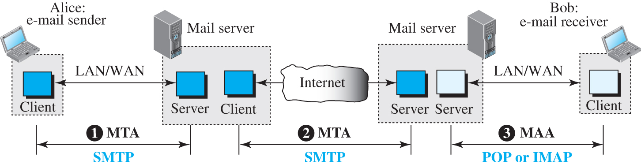
Figure 10.22 Protocols used in electronic mail
Access the text alternative for slide images.

Slide 73
Table 10.6 SMTP commands
Keyword | Argument(s) | Description
HELO | Sender’s host name | Identifies itself
MAIL FROM | Sender of the message | Identifies the sender of the message
RCPT TO | Intended recipient | Identifies the recipient of the message
DATA | Body of the mail | Sends the actual message
QUIT |  | Terminates the message
RSET |  | Aborts the current mail transaction
VRFY | Name of recipient | Verifies the address of the recipient
NOOP |  | Checks the status of the recipient
TURN |  | Switches the sender and the recipient
EXPN | Mailing list | Asks the recipient to expand the mailing list
HELP | Command name | Asks the recipient to send information about the command sent as the argument
SEND FROM | Intended recipient | Specifies that the mail be delivered only to the terminal of the recipient, and not to the mailbox
SMOL FROM | Intended recipient | Specifies that the mail be delivered to the terminal or the mailbox of the recipient
SMAL FROM | Intended recipient | Specifies that the mail be delivered to the terminal and the mailbox of the recipient

Slide 74
Table 10.7 SMTP responses 1
Code | Description
 | Positive Completion Reply
211 | System status or help reply
214 | Help message
220 | Service ready
221 | Service closing transmission channel
250 | Request command completed
251 | User not local; the message will be forwarded
 | Positive Intermediate Reply
354 | Start mail input
 | Transient Negative Completion Reply
421 | Service not available
450 | Mailbox not available
451 | Command aborted: local error
452 | Command aborted; insufficient storage

Slide 75
Table 10.7 SMTP responses 2
 | Permanent Negative Completion Reply
500 | Syntax error; unrecognized command
501 | Syntax error in parameters or arguments
502 | Command not implemented
503 | Bad sequence of commands
504 | Command temporarily not implemented
550 | Command is not executed; mailbox unavailable
551 | User not local
552 | Requested action aborted; exceeded storage location
553 | Requested action not taken; mailbox name not allowed
554 | Transaction failed

Slide 76
Example 10.13
To show the three mail transfer phases, we show all of the steps described above using the information depicted in Figure 10.23. In the figure, we have separated the messages related to the envelope, header, and body in the data transfer section. Note that the steps in this figure are repeated two times in each e-mail transfer: once from the e-mail sender to the local mail server and once from the local mail server to the remote mail server. The local mail server, after receiving the whole e-mail message, may spool it and send it to the remote mail server at another time.

Slide 77
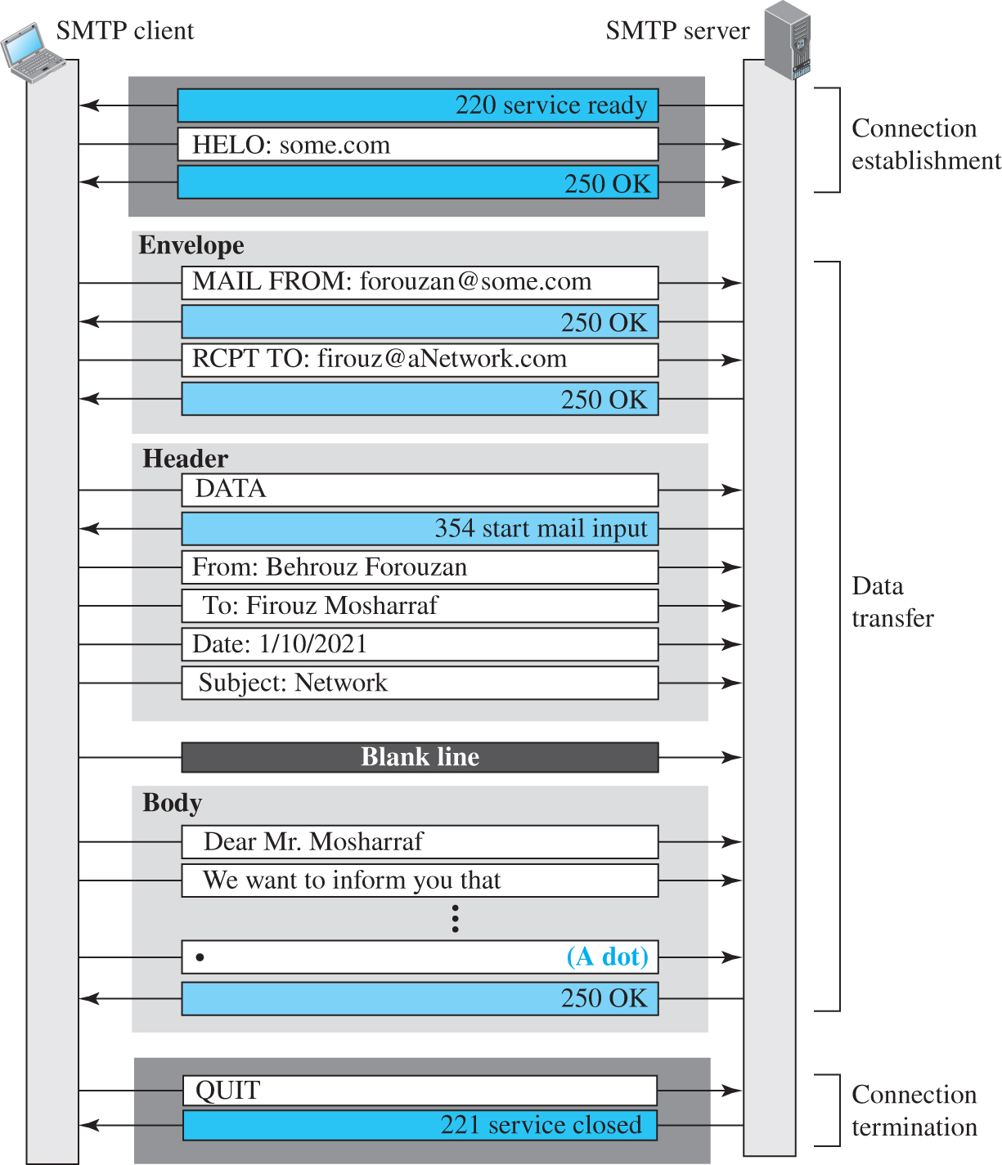
Figure 10.23 Example 10.13
Access the text alternative for slide images.

Slide 78
Message Access Agent: POP and IMAP
The first and second stages of mail delivery use SMTP. However, SMTP is not involved in the third stage because SMTP is a push protocol; it pushes the message from the client to the server. In other words, the direction of the bulk data (messages) is from the client to the server. On the other hand, the third stage needs a pull protocol; the client must pull messages from the server. The direction of the bulk data is from the server to the client. The third stage uses a message access agent.

Slide 79
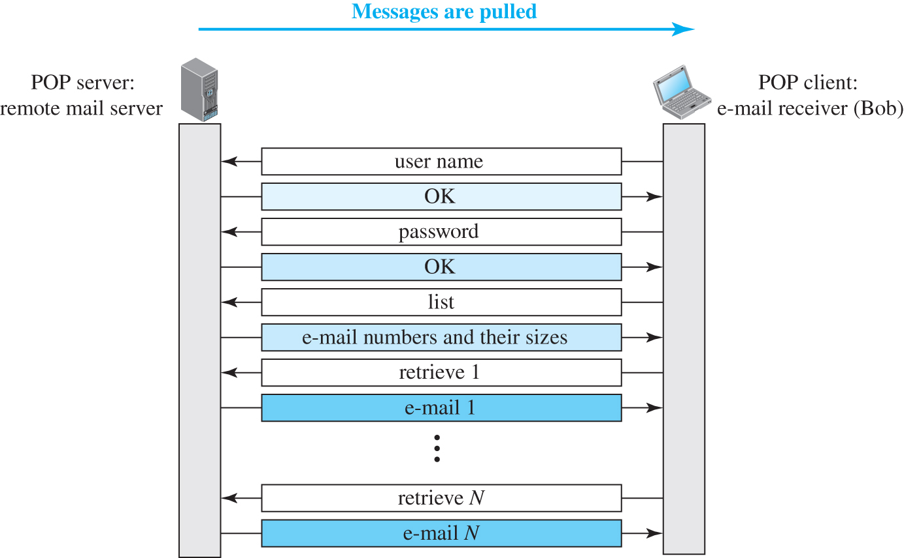
Figure 10.24 POP3
Access the text alternative for slide images.

Slide 80
MIME
Electronic mail has a simple structure. Its simplicity, however, comes with a price. It can send messages only in NVT 7-bit ASCII format. In other words, it has some limitations. It cannot be used for languages other than English (such as French, German, Hebrew, Russian, Chinese, and Japanese). Also, it cannot be used to send binary files or video or audio data.
Multipurpose Internet Mail Extensions (MIME) is a supplementary protocol that allows non-ASCII data to be sent through e-mail.

Slide 81
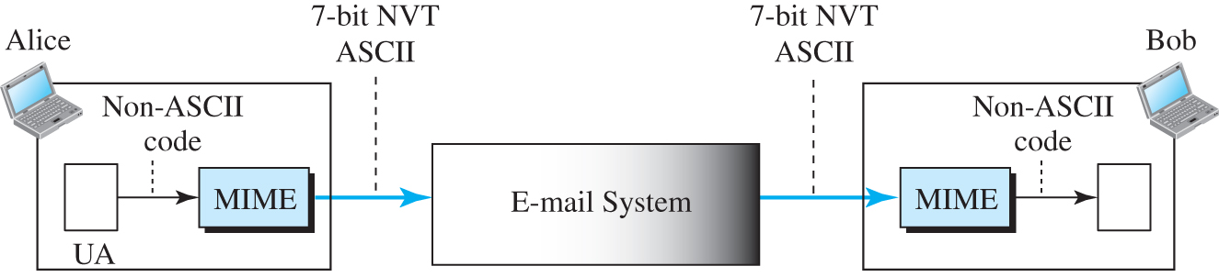
Figure 10.25 MIME
Access the text alternative for slide images.

Slide 82
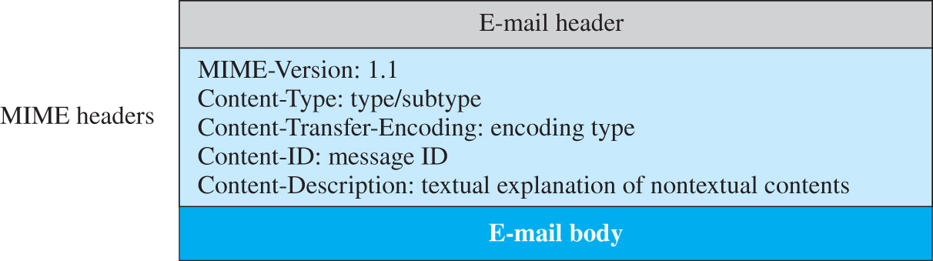
Figure 10.26 MIME header
Access the text alternative for slide images.

Slide 83
Table 10.8 Data types and subtypes in MIME
Type | Subtype | Description
Text | Plain | Unformatted
 | HTML | HTML format (see Appendix C)
 | Mixed | Body contains ordered parts of different data types
Multipart | Parallel | Same as above, but no order
 | Digest | Similar to Mixed, but the default is message/RFC822
 | Alternative | Parts are different versions of the same message
 | RFC822 | Body is an encapsulated message
Message | Partial | Body is a fragment of a bigger message
 | External-Body | Body is a reference to another message
Image | JPEG | Image is in JPEG format
 | GIF | Image is in GIF format
Video | MPEG | Video is in MPEG format
Audio | Basic | Single channel encoding of voice at 8 kHz
Application | PostScript | Adobe PostScript
 | Octet-stream | General binary data (8-bit bytes)

Slide 84
Table 10.9 Methods for content-transfer-encoding
Type | Description
7-bit | NVT ASCII characters with each line less than 1000 characters
8-bit | Non-ASCII characters with each line less than 1000 characters
Binary | Non-ASCII characters with unlimited-length lines
Base64 | 6-bit blocks of data encoded into 8-bit ASCII characters
Quoted-printable | Non-ASCII characters encoded as an equal sign plus an ASCII code

Slide 85
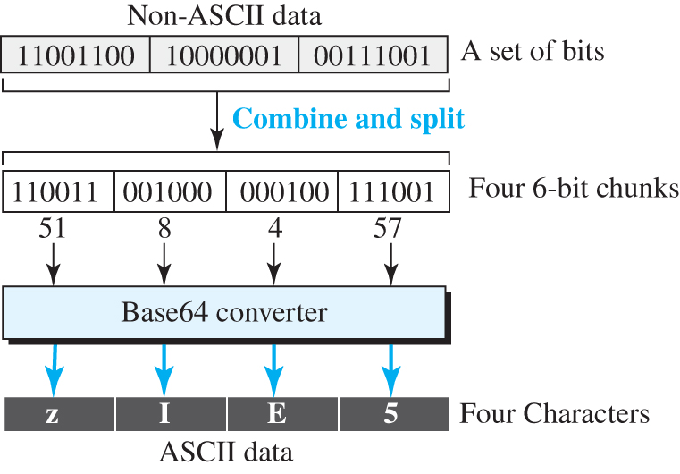
Figure 10.27 Base64 conversion
Access the text alternative for slide images.

Slide 86
Table 10.10 Base64 converting table
Value | Code | Value | Code | Value | Code | Value | Code | Value | Code | Value | Code
0 | A | 11 | L | 22 | W | 33 | h | 44 | s | 55 | 3
1 | B | 12 | M | 23 | X | 34 | i | 45 | t | 56 | 4
2 | C | 13 | N | 24 | Y | 35 | j | 46 | u | 57 | 5
3 | D | 14 | O | 25 | Z | 36 | k | 47 | v | 58 | 6
4 | E | 15 | P | 26 | a | 37 | l | 48 | w | 59 | 7
5 | F | 16 | Q | 27 | b | 38 | m | 49 | x | 60 | 8
6 | G | 17 | R | 28 | c | 39 | n | 50 | y | 61 | 9
7 | H | 18 | S | 29 | d | 40 | o | 51 | z | 62 | +
8 | I | 19 | T | 30 | e | 41 | p | 52 | 0 | 63 | /
9 | J | 20 | U | 31 | f | 42 | q | 53 | 1
10 | K | 21 | V | 32 | g | 43 | r | 54 | 2

Slide 87
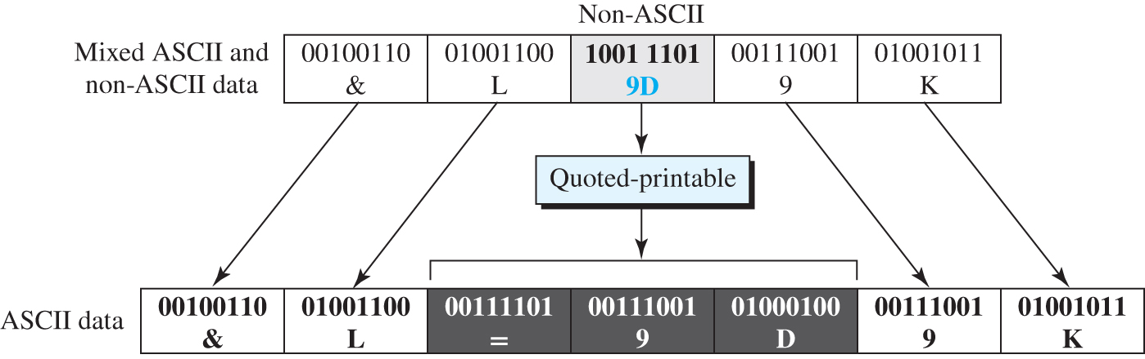
Figure 10.28 Quoted-printable
Access the text alternative for slide images.

Slide 88
Web-Based Mail
E-mail is such a common application that some websites today provide this service to anyone who accesses the site. Three common sites are Hotmail, Yahoo, and Google mail. The idea is very simple. Figure 10.29 shows two cases.

Slide 89
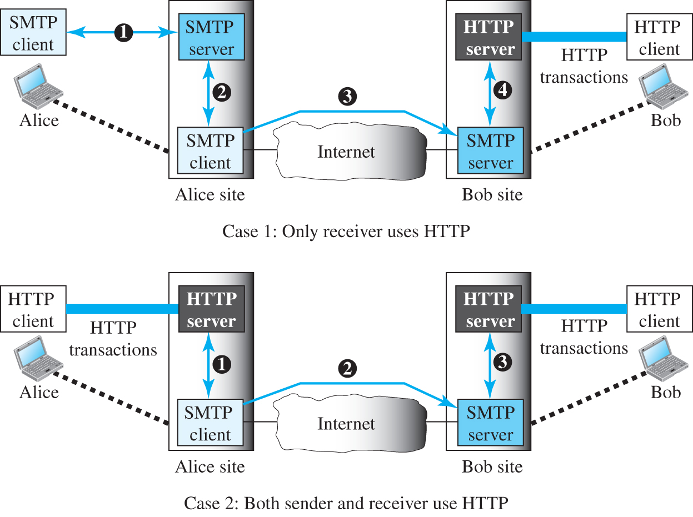
Figure 10.29 Web-based e-mail, cases I and II
Access the text alternative for slide images.

Slide 90
E-Mail Security
The protocol discussed in this chapter does not provide any security provisions per se. However, e-mail exchanges can be secured using two application-layer securities designed in particular for e-mail systems. Two of these protocols, Pretty Good Privacy (PGP) and Secure/Multipurpose Internet Mail Extensions (S/MIME), are discussed in Chapter 13 after we have discussed basic network security.

Slide 91
10.3.4 TELNET
A server program can provide a specific service to its corresponding client program. However, it is impossible to have a client/server pair for each type of service we need; the number of servers soon becomes intractable. One of the original remote logging protocols is TELNET, which is an abbreviation for TErminaL NETwork. Although TELNET requires a logging name and password, it is vulnerable to hacking because it sends all data including the password in plaintext (not encrypted).

Slide 92
Local versus Remote Logging
We first discuss the concept of local and remote logging as shown in Figure 10.30.

Slide 93
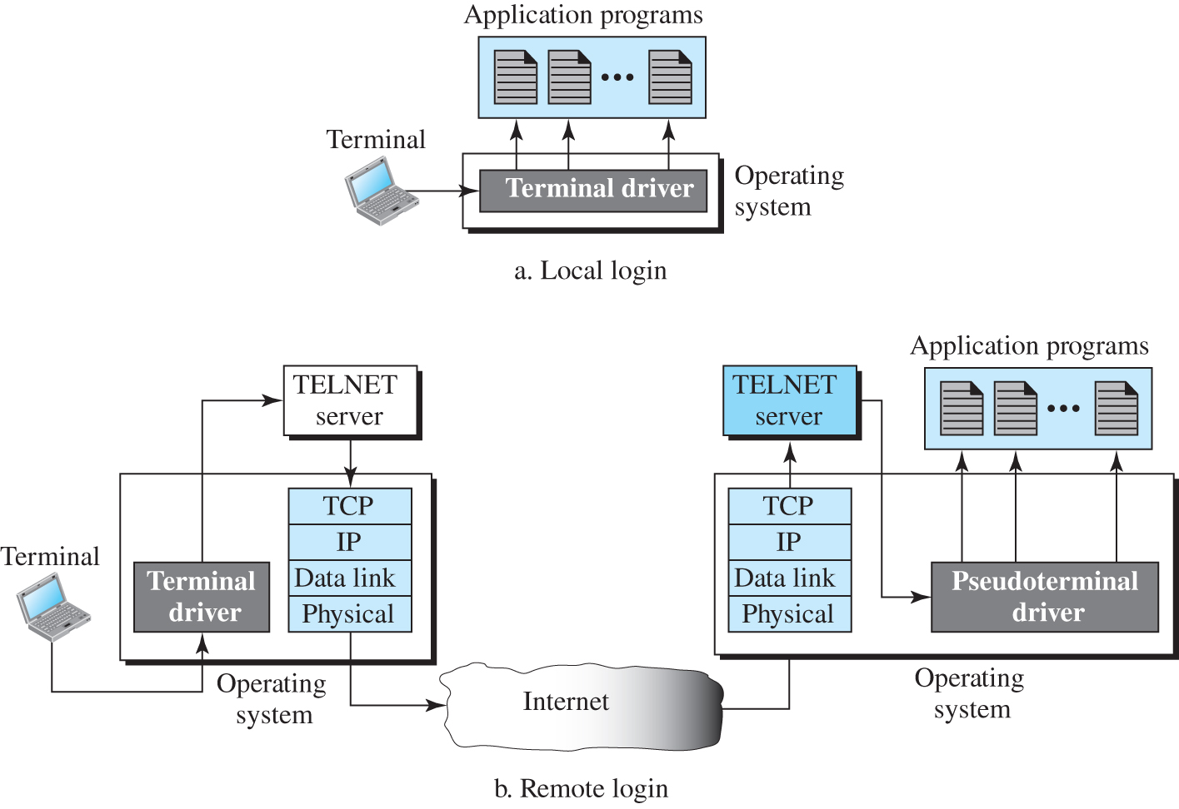
Figure 10.30 Local versus remote logging
Access the text alternative for slide images.

Slide 94
Network Virtual Terminal (NVT)
The mechanism to access a remote computer is complex. This is because every computer and its operating system accepts a special combination of characters as tokens. For example, the end-of-file token in a computer running the DOS operating system is Ctrl+z, while the UNIX operating system recognizes Ctrl+d.

Slide 95
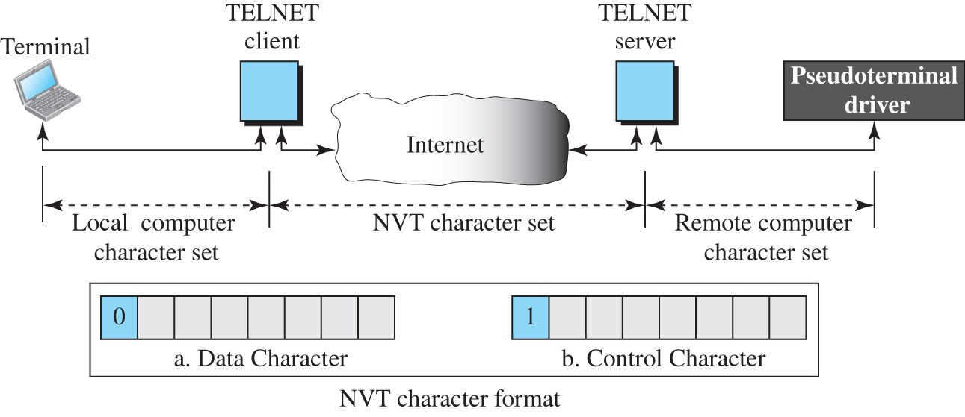
Figure 10.31 Concept of NVT
Access the text alternative for slide images.

Slide 96
Operation
TELNET lets the client and server negotiate options before or during the use of the service. Options are extra features available to a user with a more sophisticated terminal. Users with simpler terminals can use default features.

Slide 97
User Interface
The operating system (UNIX, for example) defines an interface with user-friendly commands. An example of such a set of commands can be found in Table 10.11.

Slide 98
Table 10.11 Examples of interface commands
Command | Meaning | Command | Meaning
open | Connect to a remote computer | set | Set the operating parameters
close | Close the connection | status | Display the status information
display | Show the operating parameters | send | Send special characters
mode | Change to line or character mode | quit | Exit TELNET

Slide 99
10.3.5 Secure Shell (SSH)
Although Secure Shell (SSH) is a secure application program that can be used today for several purposes such as remote logging and file transfer, it was originally designed to replace TELNET. There are two versions of SSH: SSH-1 and SSH-2, which are totally incompatible. The first version, SSH-1, is now deprecated because of security flaws in it. In this section, we discuss only SSH-2.

Slide 100
Components
SSH is an application-layer protocol with three components, as shown in Figure 10.32.

Slide 101
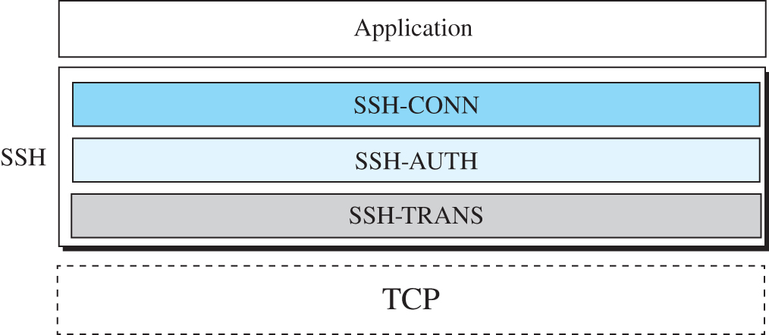
Figure 10.32 Components of SSH

Slide 102
Applications 1
Although SSH is often thought of as a replacement for TELNET, SSH is, in fact, a general-purpose protocol that provides a secure connection between a client and server.

Slide 103
Port Forwarding
One of the interesting services provided by the SSH protocol is port forwarding. We can use the secured channels available in SSH to access an application program that does not provide security services. Applications such as TELNET and Simple Mail Transfer Protocol (SMTP), which are discussed later, can use the services of the SSH port forwarding mechanism. The SSH port forwarding mechanism creates a tunnel through which the messages belonging to other protocols can travel. For this reason, this mechanism is sometimes referred to as SSH tunneling. Figure 10.33 shows the concept of port forwarding for securing the FTP application.

Slide 104
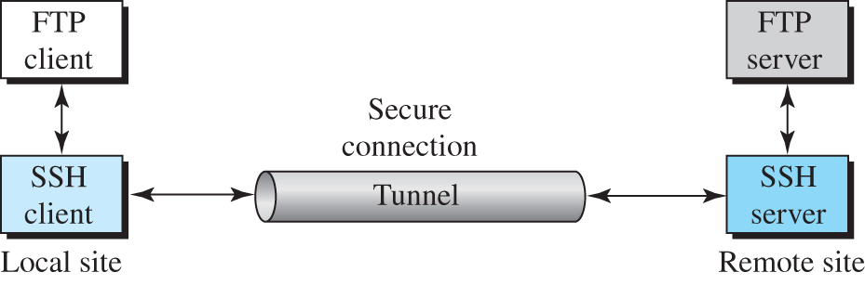
Figure 10.33 Port forwarding
Access the text alternative for slide images.

Slide 105
Format of the SSH Packets
Figure 10.34 shows the format of packets used by the SSH protocols.

Slide 106
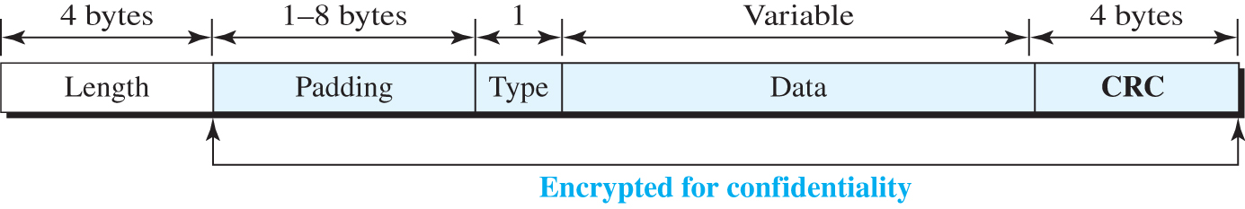
Figure 10.34 SSH packet format
Access the text alternative for slide images.

Slide 107
10.3.6 Domain Name System (DNS)
The last client-server application program we discuss has been designed to help other application programs. The Internet needs to have a directory system that can map a name to an address. This is analogous to the telephone network. Figure 10.35 shows how TCP/IP uses a DNS client and a DNS server to map a name to an address.

Slide 108
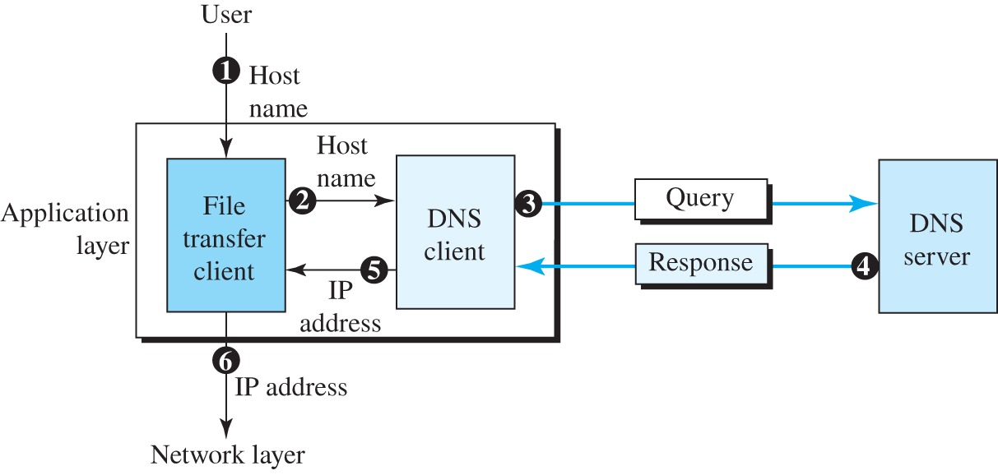
Figure 10.35 Purpose of DNS
Access the text alternative for slide images.

Slide 109
Name Space
To be unambiguous, the names assigned to machines must be carefully selected from a name space with complete control over the binding between the names and IP addresses. In other words, the names must be unique because the addresses are unique. A name space that maps each address to a unique name can be organized in two ways: flat or hierarchical.

Slide 110
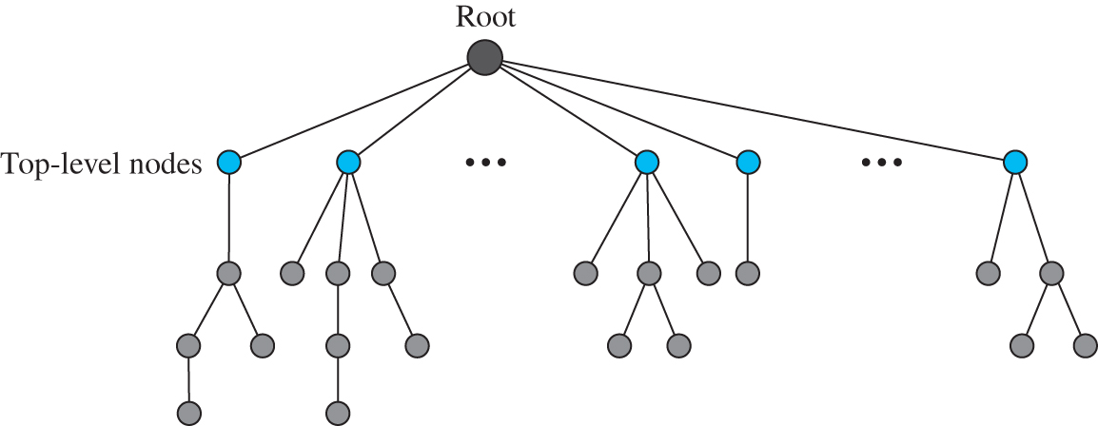
Figure 10.36 Domain name space
Access the text alternative for slide images.

Slide 111
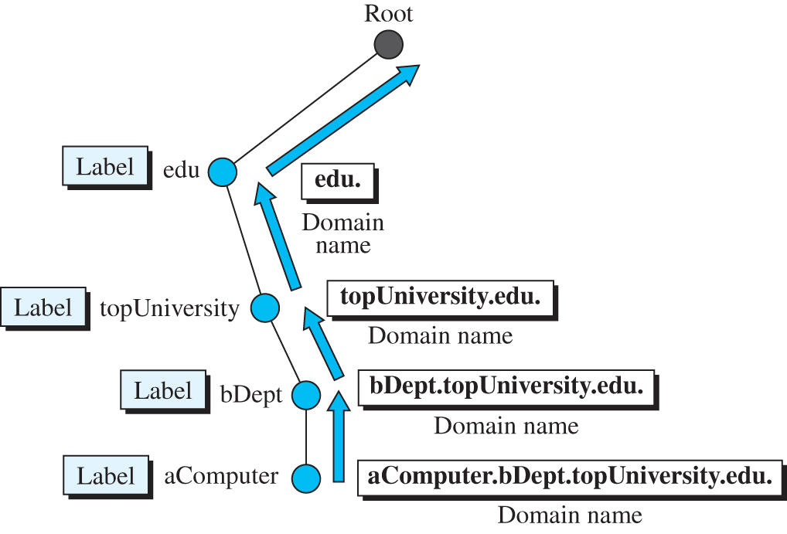
Figure 10.37 Domain names and labels
Access the text alternative for slide images.

Slide 112
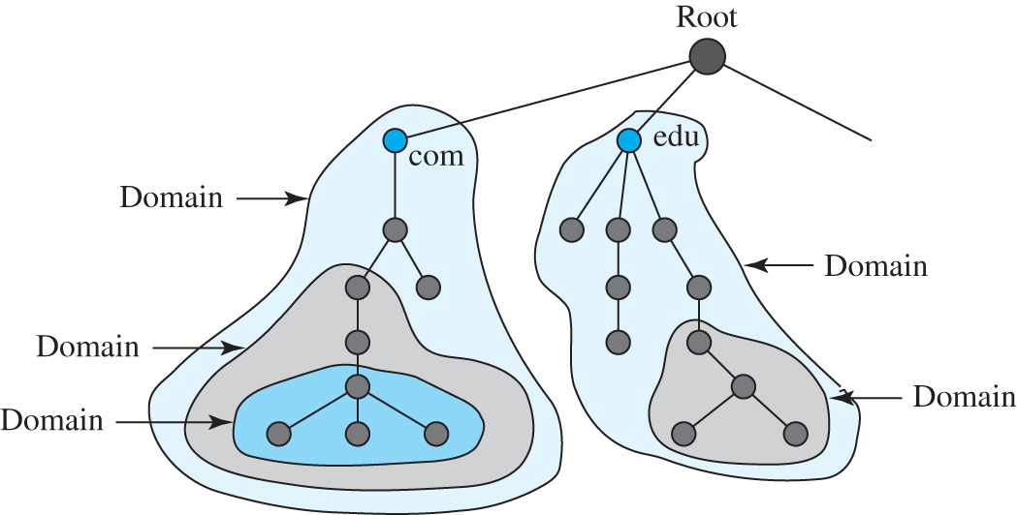
Figure 10.38 Domains
Access the text alternative for slide images.

Slide 113
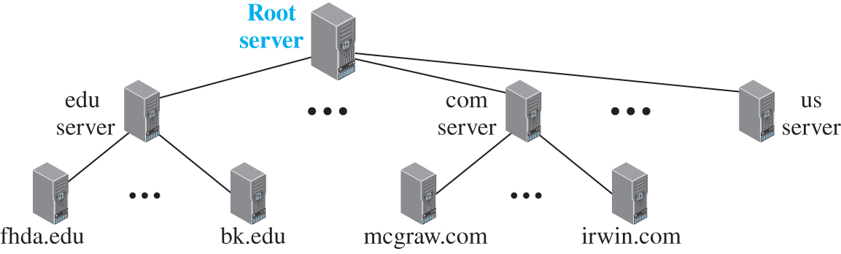
Figure 10.39 Hierarchy of name servers
Access the text alternative for slide images.

Slide 114
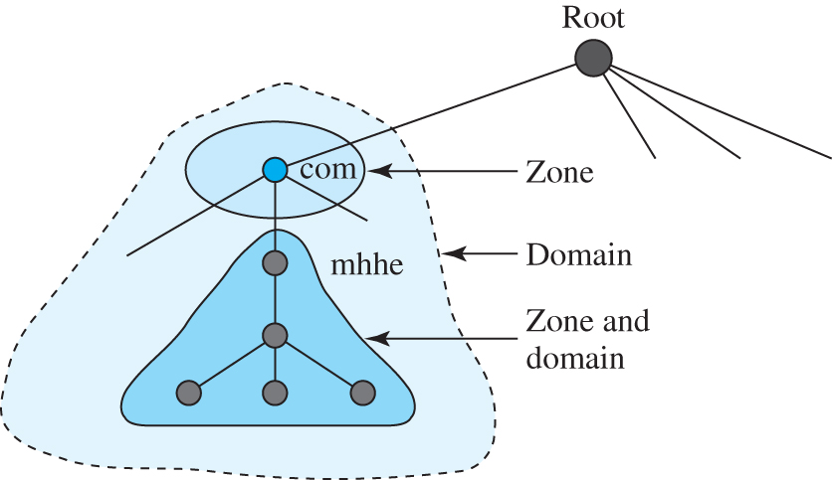
Figure 10.40 Zone
Access the text alternative for slide images.

Slide 115
DNS in the Internet
DNS is a protocol that can be used in different platforms. In the Internet, the domain name space (tree) was originally divided into three different sections: generic domains, country domains, and the inverse domains. However, due to the rapid growth of the Internet, it became extremely difficult to keep track of the inverse domains, which could be used to find the name of a host when given the IP address. The inverse domains are now deprecated. We, therefore, concentrate on the first two.

Slide 116
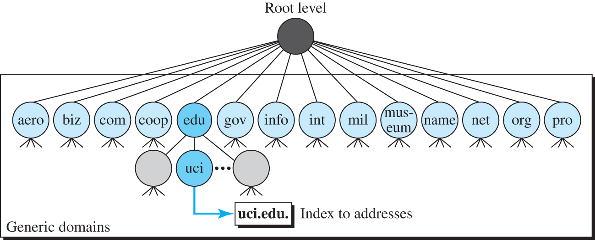
Figure 10.41 Generic domains
Access the text alternative for slide images.

Slide 117
Table 10.12 Generic domain labels
Label | Description | Label | Description
aero | Airlines and aerospace | int | International organizations
biz | Businesses or firms | mil | Military groups
com | Commercial organizations | museum | Museum
coop | Cooperative organizations | name | Personal names (individuals)
edu | Educational institutions | net | Network support centers
gov | Government institutions | org | Nonprofit organizations
info | Information service providers | pro | Professional organizations

Slide 118
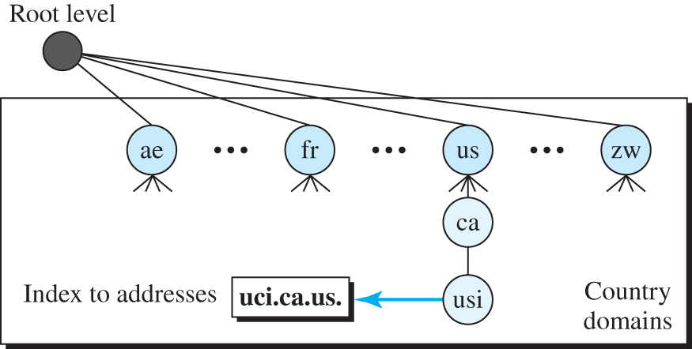
Figure 10.42 Country domains
Access the text alternative for slide images.

Slide 119
Resolution
Mapping a name to an address is called name-address resolution. DNS is designed as a client-server application. A host that needs to map an address to a name or a name to an address calls a DNS client called a resolver. The resolver accesses the closest DNS server with a mapping request. If the server has the information, it satisfies the resolver; otherwise, it either refers the resolver to other servers or asks other servers to provide the information.

Slide 120
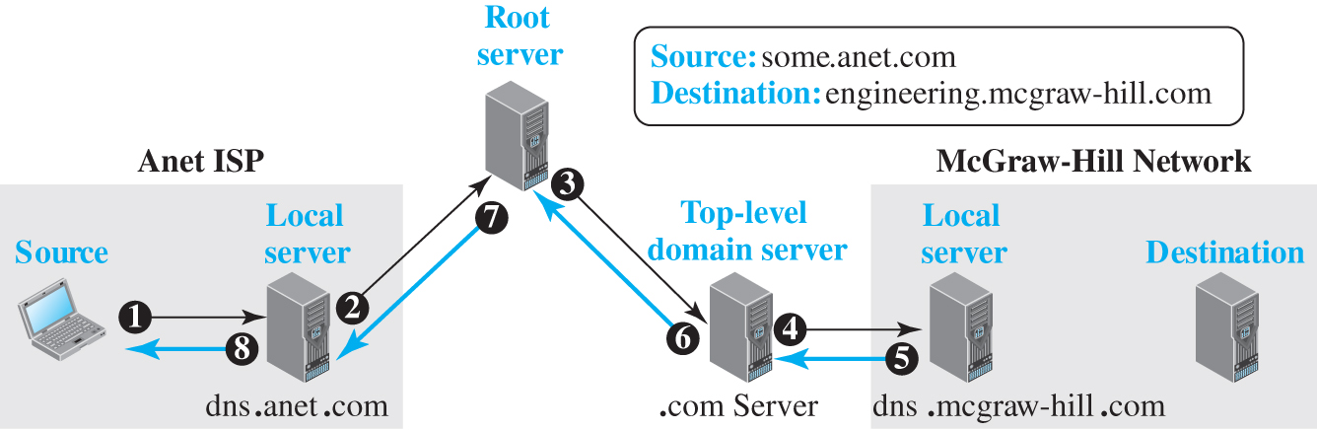
Figure 10.43 Recursive resolution
Access the text alternative for slide images.

Slide 121
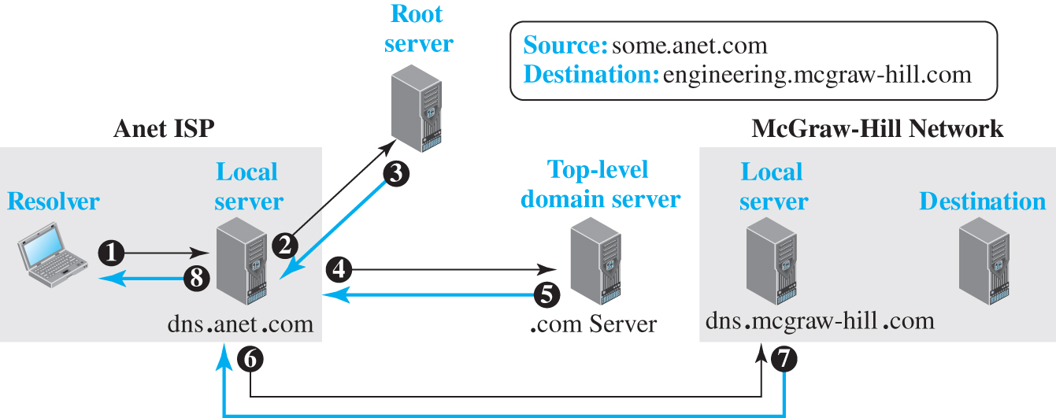
Figure 10.44 Iterative resolution
Access the text alternative for slide images.

Slide 122
Resource Records
The zone information associated with a server is implemented as a set of resource records. In other words, a name server stores a database of resource records. A resource record is a 5-tuple structure, as shown below:
(Domain Name, Type, Class, TTL, Value)

Slide 123
Table 10.13 DNS types
Type | Interpretation of value
A | A 32-bit IPv4 address (see Chapter 7)
NS | Identifies the authoritative servers for a zone
CNAME | Defines an alias for the official name of a host
SOA | Marks the beginning of a zone
MX | Redirects mail to a mail server
AAAA | An IPv6 address (see Chapter 7)

Slide 124
DNS Messages
To retrieve information about hosts, DNS uses two types of messages: query and response. Both types have the same format as shown in Figure 10.45.

Slide 125
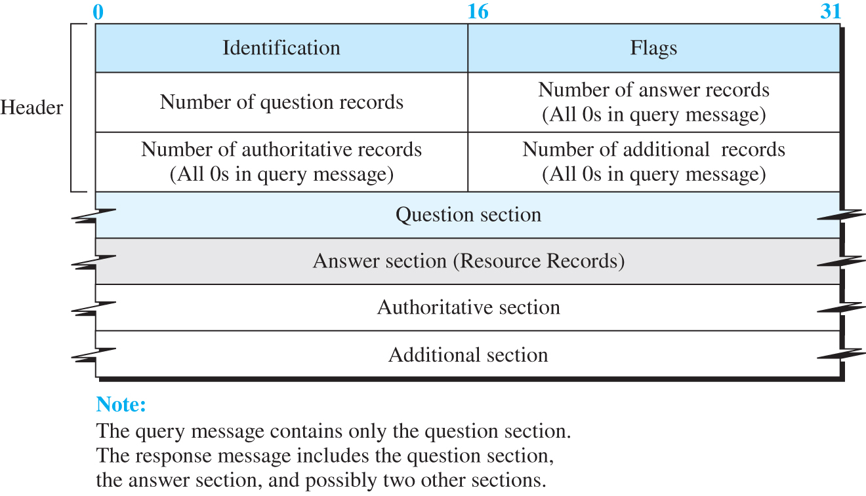
Figure 10.45 DNS message
Access the text alternative for slide images.

Slide 126
Example 10.14
In UNIX and Windows, the nslookup utility can be used to retrieve address/name mapping. The following shows how we can retrieve an address when the domain name is given.
$nslookup www.forouzan.biz
Name: www.forouzan.biz
Address: 198.170.240.179

Slide 127
Encapsulation
DNS can use either UDP or TCP. In both cases the well-known port used by the server is port 53. UDP is used when the size of the response message is less than 512 bytes because most UDP packages have a 512-byte packet size limit. If the size of the response message is more than 512 bytes, a TCP connection is used. In that case, one of two scenarios can occur.

Slide 128
Registrars
How are new domains added to DNS? This is done through a registrar, a commercial entity accredited by ICANN. A registrar first verifies that the requested domain name is unique and then enters it into the DNS database.

Slide 129
DDNS
When the DNS was designed, no one predicted that there would be so many address changes. In DNS, when there is a change, such as adding a new host, removing a host, or changing an IP address, the change must be made to the DNS master file. These types of changes involve a lot of manual updating. The size of today’s Internet does not allow for this kind of manual operation.

Slide 130
Security of DNS
DNS is one of the most important systems in the Internet infrastructure; it provides crucial services to Internet users. Applications such as Web access or e-mail are heavily dependent on the proper operation of DNS.

Slide 131
10-4 PEER-TO-PERR PARADIGM
In this section, we discuss the peer-to peer paradigm. Peer-to-peer gained popularity with Napster, an online music file. Napster paved the way for peer-to-peer file-distribution models that came later. Gnutella was followed by Fast-Track, BitTorrent, WinMX, and GNUnet.

Slide 132
10.4.1 P2P Networks
Internet users that are ready to share their resources become peers and form a network. When a peer in the network has a file) to share, it makes it available to the rest of the peers. An interested peer can connect itself to the computer where the file is stored and download it. After a peer downloads a file, it can make it available for other peers to download. As more peers join and download that file, more copies of the file become available to the group.

Slide 133
Centralized Networks
In a centralized P2P network, the directory uses the client-server paradigm, but the storing and downloading of the files are done using the peer-to-peer paradigm. For this reason, a centralized P2P network is sometimes referred to as a hybrid P2P network. Napster was an example of a centralized P2P. In this type of network, a peer first registers itself with a central server. The peer then provides its IP address and a list of files it has to share. To avoid system collapse, Napster used several servers for this purpose, but we show only one in Figure 10.46.

Slide 134
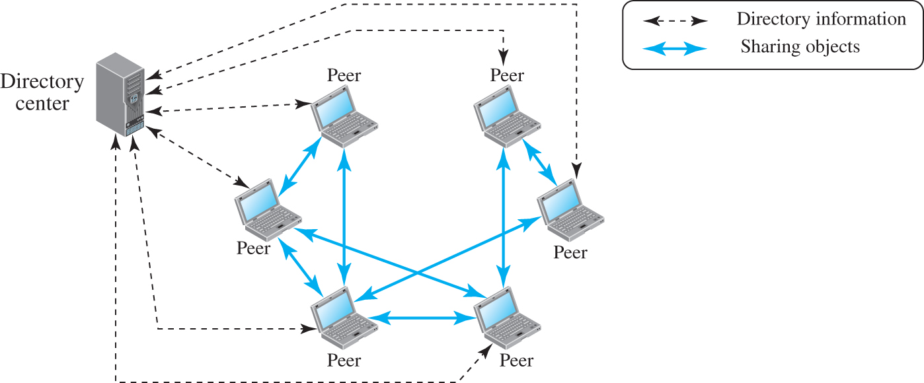
Figure 10.46 Centralized network
Access the text alternative for slide images.

Slide 135
Decentralized Network
A decentralized P2P network does not depend on a centralized directory system. In this model, peers arrange themselves into an overlay network, which is a logical network made on top of the physical network. Depending on how the nodes in the overlay network are linked, a decentralized P2P network is classified as either unstructured or structured.

Slide 136
10.4.2 Distributed Hash Function
A Distributed Hash Table (DHT) distributes data among a set of nodes according to some predefined rules. Each peer in a DHT-based network becomes responsible for a range of data items. To avoid the flooding overhead that we discussed for unstructured P2P networks, DHT-based networks allow each peer to have a partial knowledge about the whole network. This knowledge can be used to route the queries about the data items to the responsible nodes using effective and scalable procedures.

Slide 137
Address Space
In a DHT-based network, each data item and the peer is mapped to a point in a large address of size 2m. The address space is designed using modular arithmetic, which means that we can think of points in the address space as distributed evenly on a circle with 2m points (0 to 2m - 1) using clockwise direction as shown in Figure 10.47. Most of the DHT implementations use m = 160.

Slide 138
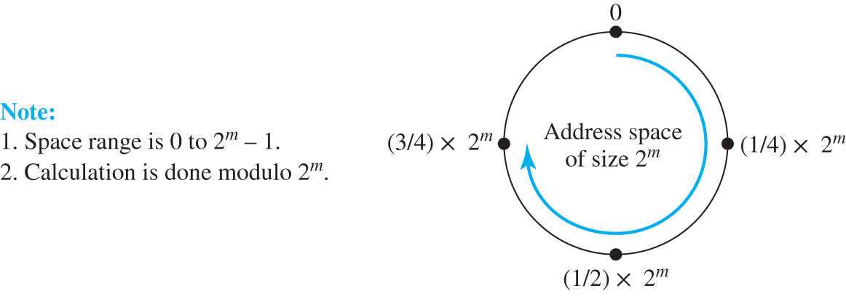
Figure 10.47 Address space
Access the text alternative for slide images.

Slide 139
Example 10.15
Although the normal value of m is 160, for the purpose of demonstration, we use m = 5 to make our examples tractable. In Figure 2.48, we assume that several peers have already joined the group. The node N5 with IP address 110.34.56.20 has a file named Liberty that wants to share with its peers. The node makes a hash of the file name, “Liberty,” to get the key = 14. Since the closest node to key 14 is node N17, N5 creates a reference to file name (key), its IP address, and the port number (and possibly some other information about the file) and sends this reference to be stored in node N17. In other words, the file is stored in N5, the key of the file is k14 (a point in the DHT ring), but the reference to the file is stored in node N17.

Slide 140
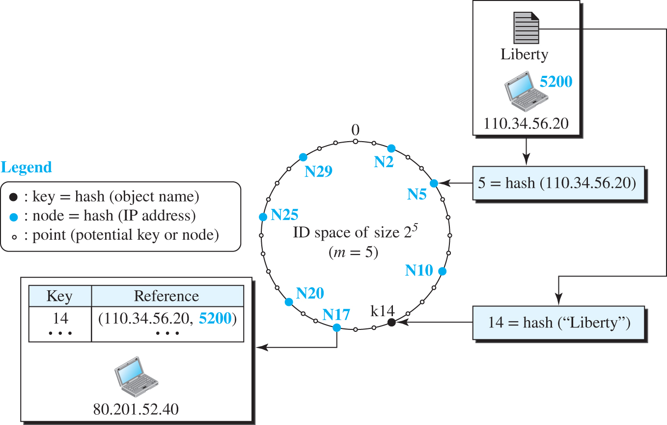
Figure 10.48 Example 10.15
Access the text alternative for slide images.

Slide 141
10.4.3 Chord
There are several protocols that implement DHT systems. In this section, we introduce the Chord protocol for its simplicity and elegant approach to routing queries. Chord was published by Stoica et al in 2001. We briefly discuss the main feature of this algorithm here.

Slide 142
Identifier Space 1
Data items and nodes in Chord are m-bit identifiers that create an identifier space of size 2m points distributed in a circle in the clockwise direction. We refer to the identifier of a data item as k (for key) and the identifier of a peer as N (for node). Arithmetic in the space is done modulo 2m, which means that the identifiers are wrapped from 2m - 1 back to 0. Although some implementations use a collision-resistant hash function like SHA1 with m = 160, we use m = 5 in our discussion to make the discussion simpler.

Slide 143
Finger Table
A node in the Chord algorithm should be able to resolve a query: given a key, the node should be able to find the node identifier responsible for that key or forward the query to another node. Forwarding, however, means that each node needs to have a routing table. Chord requires that each node knows about m successor nodes and one predecessor node. Each node creates a routing table, called a finger table by Chord, that looks like Table 10.14. Note that the target key at row i is N + 2 ^ (i-1).

Slide 144
Table 10.14 Finger table
i | Target Key | Successor of Target Key | Information about Successor
1 | N + 1 | Successor of N + 1 | IP address and port of successor
2 | N + 2 | Successor of N + 2 | IP address and port of successor
⋮ | ⋮ | ⋮ | ⋮
m |  | Successor of | IP address and port of successor

Slide 145
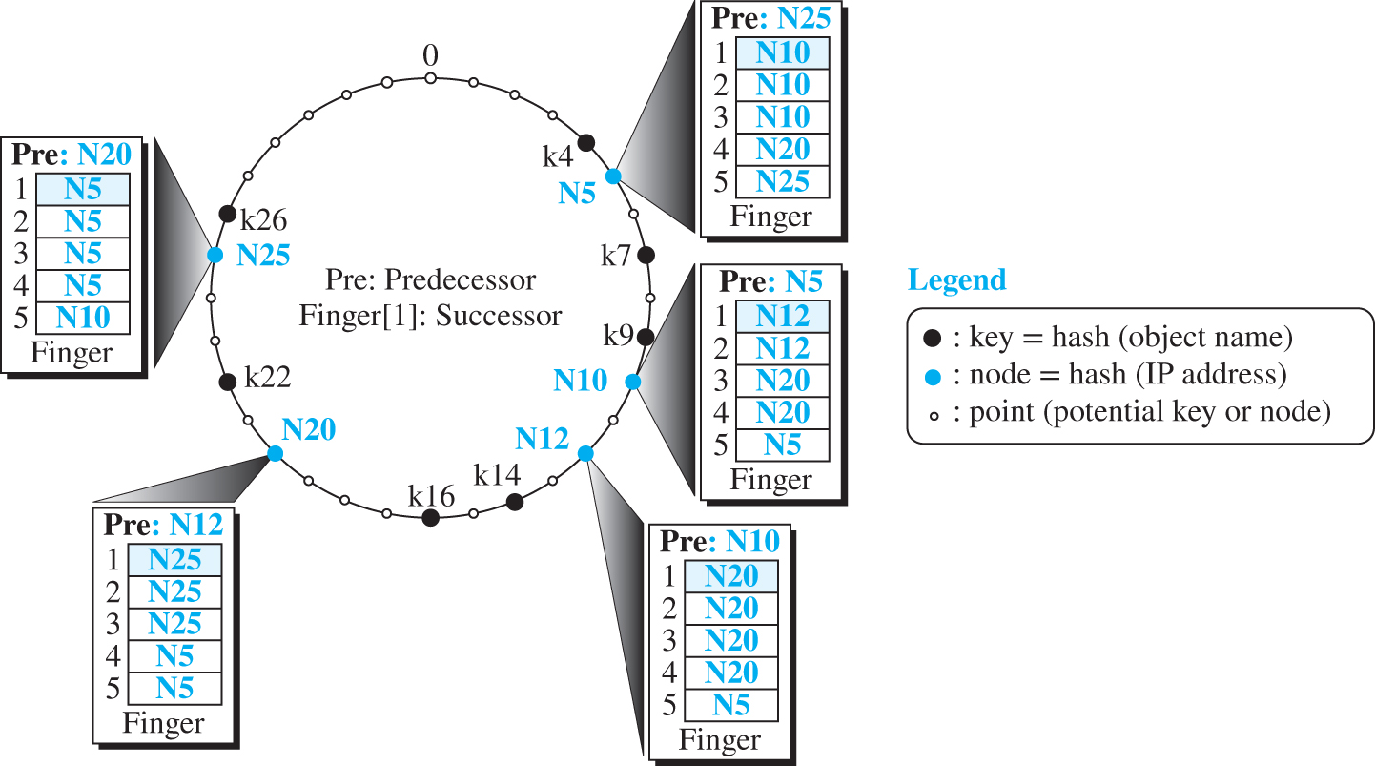
Figure 10.49 An example of a ring in Chord
Access the text alternative for slide images.

Slide 146
Table 10.15 Lookup 1
Lookup (key)
{
if (node is responsible for the key)
return (node’s ID)
else
return find_succesor (key)
}
find_successor (id)
{
x = find_ predecessor (id)
return x.finger[1]
}

Slide 147
Table 10.15 Lookup 2
find_predecessor (id)
{
x = N // N is the current node
while (id ∉ (x, x.finger[1]))
{
x = x.find_closest_predecessor (id) // Let x find it
}
return x
}
find_closest_predecessor (id)
{
for (i = m downto 1)
{
if (finger [i] ∈ (N, id)) //N is the current node
return (finger [i])
}
return N //The node itself is closest predecessor
}

Slide 148
Example 10.16
Assume node N5 in Figure 10.49 needs to find the responsible node for key k14. Figure 10.50 shows the sequence of 8 events to do so.

Slide 149
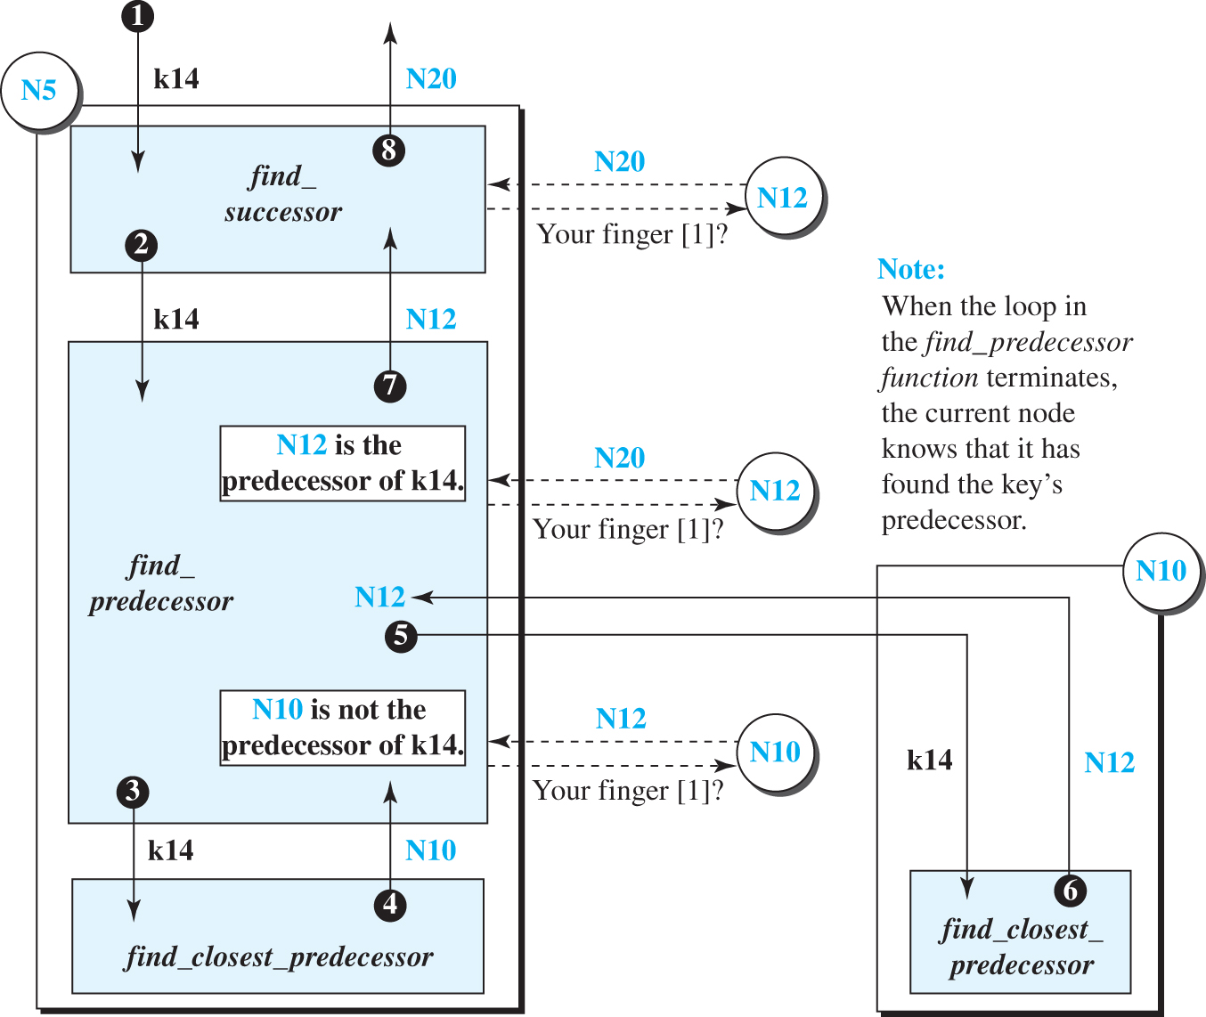
Figure 10.50 Example 10.16
Access the text alternative for slide images.

Slide 150
Table 10.16 Stabilize
Stabilize ()
{
P = finger[1].Pre //Ask the successor to return its predecessor
if (P ∈ (N, finger[1])) finger[1] = P // P is the possible successor of N
finger[1].notify (N) // Notify P to change its predecessor
}
Notify (x)
{
if (Pre = null or x ∈ (Pre, N)) Pre = x
}

Slide 151
Table 10.17 Fix_Finger
Fix_Finger ()
{
Generate (i ∈ (1, m]) //Randomly generate i such as 1 < i ⩽ m
finger[i] = find_successor // Find value of finger[i]
}

Slide 152
Table 10.18 Join
Join (x)
{
Initialize (x)
finger[1].Move_Keys (N)
}
Initialize (x)
{
Pre = null
if (x = null) finger[1] = N
else finger[1] = x. Find_Successor (N)
}
Move_Keys (x)
{
for (each key k)
{
if (x ∈ [k, N)) move (k to node x) // N is the current node
}
}

Slide 153
Example 10.17
We assume that node N17 joins the ring in Figure 10.49 with the help of N5. Figure 10.51 shows the ring after the ring has been stabilized. The following five steps shows the process:
N17 set its predecessor to null and its successor to N20.
N17 then asks N20 to send k14 and k16 to N17.
N17 validates its own successor and asks N20 to change its predecessor to N17
The predecessor of N17 is updated to N12.
The finger table of nodes N17, N10, N5, and N12 is changed.

Slide 154

Figure 10.51 Example 10.17
Access the text alternative for slide images.

Slide 155
Example 10.18
We assume that a node, N10, leaves the ring in Figure 2.51. Figure 2.52 shows the ring after it has been stabilized. The following shows the process:
Node N5 finds out about N10’s departure when it does not receive a pong message to its ping message. Node N5 changes its successor to N12 in the list of successors.
Node N5 immediately launches the stabilize function and asks N12 to change its predecessor to N5.
Hopefully, k7 and k9, which were under the responsibility of N10, have been duplicated in N12 before the departure of N10.
Nodes N5 and N25 update their finger tables.

Slide 156

Figure 10.52 Example 10.18
Access the text alternative for slide images.

Slide 157
Applications 2
Chord is used in several applications including Collaborative File System (CFS), ConChord, and Distributive Domain Name System (DDNS).

Slide 158
10.4.4 Pastry
Another popular protocol in the P2P paradigm is Pastry, designed by Rowstron and Druschel. Pastry uses DHT, as described before, but there are some fundamental differences between Pastry and Chord in the identifier space and routing process that we describe next.

Slide 159
Identifier Space 2
In Pastry, like Chord, nodes and data items are m-bit identifiers that create an identifier space of 2^m points distributed uniformly on a circle in the clockwise direction. The common value for m is 128. The protocol uses the SHA-1 hashing algorithm with m = 128. However, in this protocol, an identifier is seen as an n-digit string in base 2b in which b is normally 4 and n = (m / b). In other words, an identifier is a 32-digit number in base 16 (hexadecimal).

Slide 160
Routing
A node in Pastry should be able to resolve a query; given a key, the node should be able to find the node identifier responsible for that key or forward the query to another node. Each node in Pastry uses two entities to do so: a routing table and a leaf set.

Slide 161
Table 10.19 Routing table for a node in Pastry
Common prefix length | 0 | 1 | 2 | 3 | 4 | 5 | 6 | 7 | 8 | 9 | A | B | C | D | E | F
0
1
⋮ | ⋮ | ⋮ | ⋮ | ⋮ | ⋮ | ⋮ | ⋮ | ⋮ | ⋮ | ⋮ | ⋮ | ⋮ | ⋮ | ⋮ | ⋮ | ⋮
31

Slide 162
Example 10.19
Let us assume that m = 8 bits and b = 2. This means that we have up to 2^{m} = 256 identifiers, and each identifier has m/b = 4 digits in base 2^{b} = 4. Figure 10.53 shows the situation in which there are some live nodes and some keys mapped to these nodes. The key k1213 is stored in two nodes because it is equidistant from them.

Slide 163
Lookup
As we discussed in Chord, one of the operations used in Pastry is lookup: given a key, we need to find the node that stores the information about the key or the key itself. Table 10.20 gives the lookup operation in pseudocode. In this algorithm, N is the identifier of the local node, the node that receives a message and needs to find the node that stores the key in the message.

Slide 164
Example 10.21
In Figure 10.53, we assume that node N2210 receives a query to find the node responsible for key 2008. Since this node is not responsible for this key, it first checks its leaf set. The key 2008 is not in the range of the leaf set, so the node needs to use its routing table. Since the length of the common prefix is 1, p = 1. The value of the digit at position 1 in the key is v = 0. The node checks the identifier in Table [1, 0], which is 2013. The query is forwarded to node 2013, which is actually responsible for the key. This node sends its information to the requesting node.

Slide 165
Figure 10.53 An example of a Pastry ring
Access the text alternative for slide images.

Slide 166
Table 10.20 Lookup (Pastry)
Lookup (key)
{
if (key is in the range of N’s leaf set)
forward the message to the closest node in the leaf set
else
route (key, Table)
}
route (key, Table)
{
p = length of shared prefix between key and N
v = value of the digit at position p of the key // Position starts from 0
if (Table [p, v] exists)
forward the message to the node in Table [p, v]
else
forward the message to a node sharing a prefix as long as the current node, but numerically closer to the key.
}

Slide 167
Join 1
The process of joining the ring in Pastry is simpler and faster than in Chord. The new node, X, should know at least one node N0, which should be close to X (based on the proximity metric); this can be done by running an algorithm called Nearby Node Discovery. Node X sends a join message to N0. In our discussion, we assume that N0’s identifier has no common prefix with X’s identifier.

Slide 168
Example 10.22
Figure 10.54 shows how a new node X with node identifier N2212 uses the information in four nodes in Figure 2.53 to create its initial routing table and leaf set for joining the ring. Note that the contents of these two tables will become closer to what they should be in the updating process. In this example, we assume that node 0302 is a nearby node to node 2212 based on the proximity metric.

Slide 169

Figure 10.54 Example 10.22
Access the text alternative for slide images.

Slide 170
Leave or Fail 1
Each Pastry node periodically tests the liveliness of the nodes in its leaf set and routing table by exchanging probe messages. If a local node finds that a node in its leaf set is not responding to the probe message, it assumes that the node has failed or departed. To replace it in its leaf set, the local node contacts the live node in its leaf set with the largest identifier and repairs its leaf set with the information in the leaf set of that node. Since there is an overlap in the leaf set of close-by nodes, this process is successful.

Slide 171
Application 3
Pastry is used in some applications including PAST, a distributed file system, and SCRIBE, a decentralized publish/subscribe system.

Slide 172
10.4.5 Kademlia
Another DHT peer-to-peer network is Kademlia, designed by Maymounkov and Mazières. Kademlia, like Pastry, routes messages based on the distance between nodes, but the interpretation of the distance metric in Kademlia is different from the one in Pastry, as we describe below. In this network, the distance between the two identifiers (nodes or keys) is measured as the bitwise exclusive-or (XOR), between them.

Slide 173
Identifier Space 3
In Kademlia, nodes and data items are m-bit identifiers that create an identifier space of 2m points distributed on the leaves of a binary tree. The protocol uses the SHA-1 hashing algorithm with m = 160.

Slide 174
Example 10.23
For simplicity, let us assume that m = 4. In this space, we can have 16 identifiers distributed on the leaves of a binary tree. Figure 10.55 shows the case with only eight live nodes and five keys.
As the figure shows, the key k3 is stored in N3 because 3 ⊕ 3 = 0. Although the key k7 looks numerically equidistant from N6 and N8, it is stored only in N6 because 6 ⊕ 7 = 1 but 6 ⊕ 8 = 14. Another interesting point is that the key k12 is numerically closer to N11, but it is stored in N15 because 11 ⊕ 12 = 7, but 15 ⊕ 12 = 3.

Slide 175

Figure 10.55 Example 10.23
Access the text alternative for slide images.

Slide 176
Routing Table
Kademlia keeps only one routing table for each node; there is no leaf set. Each node in the network divides the binary tree into m subtrees that do not include the node itself. Subtree i includes nodes that share i leftmost bit (common prefix) with the corresponding node. The routing table is made of m rows but only one column. In our discussion, we assume that each row holds the identifier of one of the nodes in the corresponding subtree, but later we show that Kademlia allows up to k nodes in each row. The idea is the same as that used by Pastry, but the length of the common prefix is based on the number of bits instead of the number of digits in base 2b.

Slide 177
Table 10.21 Routing table for a node in Kademlia
Common prefix length | Identifiers
0 | Closest node(s) in subtree with common prefix of length 0
1 | Closest node(s) in subtree with common prefix of length 1
⋮ | ⋮
m−1 | Closest node(s) in subtree with common prefix of length m−1

Slide 178
Example 10.24
Let us find the routing table for Example 2.23. To make the example simple, we assume that each row uses only one identifier. Since m = 4, each node has four subtrees corresponding to four rows in the routing table. The identifier in each row represents the node that is closest to the current node in the corresponding subtree. Figure 2.56 shows all routing tables, but only three of the subtrees. We have chosen these three, out of eight, to make the figure smaller.

Slide 179

Figure 10.56 Example 10.24
Access the text alternative for slide images.

Slide 180
Example 10.25
In Figure 10.56, we assume node N0 (0000)₂ receives a lookup message to find the node responsible for k12 (1100)₂. The length of the common prefix between the two identifiers is 0. Node N0 sends the message to the node in row 0 of its routing table, node N8. Now node N8 (1000)₂ needs to look for the node closest to k12 (1100)₂. The length of the common prefix between the two identifiers is 1. Node N8 sends the message to the node in row 1 of its routing table, node N15, which is responsible for k12. The routing process is terminated. The route is N0 → N8 → N15. It is interesting to note that node N15, (1111)₂, and k12, (1100)₂, have a common prefix of length 2, but row 2 of N15 is empty, which means that N15 itself is responsible for k12.

Slide 181
Example 10.26
In Figure 10.56, we assume node N5 (0101)₂ receives a lookup message to find the node responsible for k7 (0111)₂. The length of the common prefix between the two identifiers is 2. Node N5 sends the message to the node in row 2 of its routing table, node N6, which is responsible for k7. The routing process is terminated. The route is N5 → N6.

Slide 182
Example 10.27
In Figure 10.56, we assume node N11 (1011)₂ receives a lookup message to find the node responsible for k4 (0100)₂. The length of the common prefix between the two identifiers is 0. Node N11 sends the message to the node in row 0 of its routing table, node N3. Now node N3 (0011)₂ needs to look for the node closest to k4 (0100)₂. The length of the common prefix between the two identifiers is 1. Node N3 sends the message to the node in row 1 of its routing table, node N6. And so on. The route is N11 → N3→ N6 → Ν5.

Slide 183
K-Buckets
In our previous discussion, we assumed that each row in the routing table lists only one node in the corresponding subtree. For more efficiency, Kademlia requires that each row keeps at least up to k nodes from the corresponding subtree. The value of k is system independent, but for an actual network it is recommended that it be around 20. For this reason, each row in the routing table is referred to as a k-bucket. Having more than one node in each row allows the node to use an alternative node when a node leaves the network or fails. Kademlia keeps those nodes in a bucket that has been connected in the network for a long time.

Slide 184
Join 2
As in Pastry, a node that needs to join the network needs to know at least one other node. The joining node sends its identifier to the node as though it is a key to be found. The response it receives allows the new node to create its k-buckets.

Slide 185
Leave or Fail 2
When a node leaves the network or fails, other nodes update their k-buckets using the concurrent process described before.

Slide 186
10.4.6 A Popular P2P Network: BitTorrent
BitTorrent is a P2P protocol, designed by Bram Cohen, for sharing a large file among a set of peers. However, the term sharing in this context is different from other file sharing protocols. Instead of one peer allowing another peer to download the whole file, a group of peers takes part in the process to give all peers in the group a copy of the file. File sharing is done in a collaborating process called a torrent.

Slide 187
BitTorrent with a Tracker
In the original BitTorrent, there is another entity in a torrent, called the tracker, which, as the name implies, tracks the operation of the swarm, as described later. Figure 10.57 shows an example of a torrent with seeds, leeches, and the tracker.

Slide 188

Figure 10.57 Example of a torrent
Access the text alternative for slide images.

Slide 189
Trackerless BitTorrent
In the original BitTorrent design, if the tracker fails, new peers cannot connect to the network and updating is interrupted. There are several implementations of BitTorrent that eliminate the need for a centralized tracker. In the implementation that we describe here, the protocol still uses the tracker, but not a central one. The job of tracking is distributed among some nodes in the network. In this section, we show how Kademlia DHT can be used to achieve this goal, but we avoid becoming involved in the details of a specific protocol.

Slide 190
10-5 SOCKET-INTERFACE PROGRAMMING
In this section, we show how to write some simple client-server programs using C, a procedural programming language.

Slide 191
10.5.1 Socket Interface in C
In this section, we show how this interface is implemented in the C language. The important issue in socket interface is to understand the role of a socket in communication. The socket has no buffer to store data to be sent or received. It is capable of neither sending nor receiving data. The socket just acts as a reference or a label. The buffers and necessary variables are created inside the operating system.

Slide 192
Data Structure for Socket
The C language defines a socket as a structure (struct). The socket structure is made of five fields; each socket address itself is a structure made of five fields, as shown in Figure 10.58. Note that the programmer should not redefine this structure; it is already defined in the header files. We briefly discuss the five fields in a socket structure.

Slide 193

Figure 10.58 Socket data structure
Access the text alternative for slide images.

Slide 194
Header Files
To be able to use the definition of the socket and all procedures (functions) defined in the interface, we need a set of header files.
// "headerFiles.h"
#include <stdio.h>
#include <stdlib.h>
#include <sys/types.h>
#include <sys/socket.h>
#include <netinet/in.h>
#include <netdb.h>
#include <errno.h>
#include <signal.h>
#include <unistd.h>
#include <string.h>
#include <arpa/innet.h>
#include <sys/wait.h>

Slide 195
Iterative Communication Using UDP
As we discussed earlier, UDP provides a connectionless server, in which a client sends a request and the server sends back a response.

Slide 196

Figure 10.59 Sockets for UDP communication
Access the text alternative for slide images.

Slide 197

Figure 10.60 Flow diagram for iterative UDP communication
Access the text alternative for slide images.

Slide 198
Table 10.22 Echo server program using UDP 1
1 | // UDP echo server program
2 | #include “headerFiles.h”
3 | int main (void)
4 | {
5 | // Declare and define variables
6 | int s; // Socket descriptor (reference)
7 | int len; // Length of string to be echoed
8 | char buffer [256]; // Data buffer
9 | struct sockaddr_in servAddr; // Server (local) socket address
10 | struct sockaddr_in clntAddr; // Client (remote) socket address
11 | int clntAddrLen; // Length of client socket address
12 | // Build local (server) socket address
13 | memset (&servAddr, 0, sizeof (servAddr)); // Allocate memory
14 | servAddr.sin_family = AF_INET; // Family field
15 | servAddr.sin_port = htons (SERVER_PORT) // Default port number
16 | servAddr.sin_addr.s_addr = htonl (INADDR_ANY); // Default IP address
17 | // Create socket
18 | if ((s = socket (PF_INET, SOCK_DGRAM, 0)) < 0);

Slide 199
Table 10.22 Echo server program using UDP 2
19 | {
20 | perror (“Error: socket failed!”);
21 | exit (1);
22 | }
23 | // Bind socket to local address and port
24 | if ((bind (s, (struct sockaddr*) &servAddr, sizeof (servAddr))) < 0);
25 | {
26 | perror (“Error: bind failed!”);
27 | exit (1);
28 | }
29 | for ( ; ; ) // Run forever
30 | {
31 | // Receive String
32 | len = recvfrom (s, buffer, sizeof (buffer), 0,
33 | (struct sockaddr*)&clntAddr, &clntAddrLen);
34 | // Send String
35 | sendto (s, buffer, len, 0, (struct sockaddr*)&clntAddr, sizeof(clntAddr));
36 | } // End of for loop
37 | } // End of echo server program

Slide 200
Table 10.23 Echo client program using UDP 1
1 | // UDP echo client program
2 | #include “headerFiles.h”
3 | int main (int argc, char* argv[ ]) // Three arguments to be checked later
4 | {
5 | // Declare and define variables
6 | int s; // Socket descriptor
7 | int len; // Length of string to be echoed
8 | char* servName; // Server name
9 | int servPort; // Server port
10 | char* string; // String to be echoed
11 | char buffer [256 + 1]; // Data buffer
12 | struct sockaddr_in servAddr; // Server socket address
13 | // Check and set program arguments
14 | if (argc != 3)
15 | {
16 | printf (“Error: three arguments are needed!”);
17 | exit(1);
18 | }

Slide 201
Table 10.23 Echo client program using UDP 2
19 | servName = argv[1];
20 | servPort = atoi (argv[2]);
21 | string = argv[3];
22 | // Build server socket address
23 | memset (&servAddr, 0, sizeof (servAddr));
24 | servAddr.sin_family = AF_INET;
25 | inet_pton (AF_INET, servName, &servAddr.sin_addr);
26 | servAddr.sin_port = htons (servPort);
27 | // Create socket
28 | if ((s = socket (PF_INET, SOCK_DGRAM, 0)) < 0);
29 | {
30 | perror (“Error: -Socket failed!”);
31 | exit (1);
32 | }
33 | // Send echo string
34 | len = sendto (s, string, strlen (string), 0, (struct sockaddr)&servAddr, sizeof (servAddr));
35 | // Receive echo string
36 | recvfrom (s, buffer, len, 0, NULL, NULL);
37 | // Print and verify echoed string

Slide 202
Table 10.23 Echo client program using UDP 3
38 | buffer [len] = ’\0’;
39 | printf (“Echo string received: ”);
40 | fputs (buffer, stdout);
41 | // Close the socket
42 | close (s);
43 | // Stop the program
44 | exit (0);
45 | } // End of echo client program

Slide 203
Communication Using TCP
As we described before, TCP is a connection-oriented protocol. Before sending or receiving data, a connection needs to be established between the client and the server. After the connection is established, the two parties can send and receive chunks of data to each other as long as they have data to do so. TCP communication can be iterative (serving a client at a time) or concurrent (serving several clients at a time). In this section, we discuss only the iterative approach.

Slide 204

Figure 10.61 Sockets used in TCP communication
Access the text alternative for slide images.

Slide 205

Figure 10.62 Flow diagram for iterative TCP communication
Access the text alternative for slide images.

Slide 206

Figure 10.63 Flow diagram for data-transfer boxes
Access the text alternative for slide images.

Slide 207

Figure 10.64 Buffer used for receiving
Access the text alternative for slide images.

Slide 208
Table 10.24 Echo server program using the services of TCP 1
1 | // Echo server program
2 | #include “headerFiles.h”
3 | int main (void)
4 | {
5 | // Declare and define
6 | int ls; // Listen socket descriptor -(reference)
7 | int s; // socket descriptor (reference)
8 | char buffer [256]; // Data buffer
9 | char* ptr = buffer; // Data buffer
10 | int len = 0; // Number of bytes to send or -receive
11 | int maxLen = sizeof (buffer); // Maximum number of bytes to receive
12 | int n = 0; // Number of bytes for each recv call
13 | int waitSize = 16; // Size of waiting clients
14 | struct sockaddr_in serverAddr; // Server address
15 | struct sockaddr_in clientAddr; // Client address
16 | int clntAddrLen; // Length of client address
17 | // Create local (server) socket address
18 | memset (&servAddr, 0, sizeof (servAddr));
19 | servAddr.sin_family = AF_INET;
20 | servAddr.sin_addr.s_addr = htonl (INADDR_ANY); // Default IP address

Slide 209
Table 10.24 Echo server program using the services of TCP 2
21 | servAddr.sin_port = htons (SERV_PORT); // Default port
22 | // Create listen socket
23 | if (ls = socket (PF_INET, SOCK_STREAM, 0) < 0);
24 | {
25 | perror (“Error: Listen socket failed!”);
26 | exit (1);
27 | }
28 | // Bind listen socket to the local socket address
29 | if (bind (ls, &servAddr, sizeof (servAddr)) < 0);
30 | {
31 | perror (“Error: binding failed!”);
32 | exit (1);
33 | }
34 | // Listen to connection requests
35 | if (listen (ls, waitSize) < 0);
36 | {
37 | perror (“Error: listening failed!”);
38 | exit (1);
39 | }
40 | // Handle the connection

Slide 210
Table 10.24 Echo server program using the services of TCP 3
41 | for ( ; ; ) // Run forever
42 | {
43 | // Accept connections from client
44 | if (s = accept (ls, &clntAddr, &clntAddrLen) < 0);
45 | {
46 | perror (“Error: accepting failed!);
47 | exit (1);
48 | }
49 | // Data transfer section
50 | while ((n = recv (s, ptr, maxLen, 0)) > 0)
51 | {
52 | ptr + = n; // Move pointer along the buffer
53 | maxLen −= n; // Adjust maximum number of bytes to receive
54 | len + = n; // Update number of bytes received
55 | }
56 | send (s, buffer, len, 0); // Send back (echo) all bytes received
57 | // Close the socket
58 | close (s);
59 | } // End of for loop
60 | } // End of echo server program

Slide 211
Table 10.25 Echo client program using the services of TCP
1 | // TCP echo client program
2 | #include “headerFiles.h”
3 | int main (int argc, char* argv[ ]) // Three arguments to be checked later
4 | {
5 | // Declare and define
6 | int s; // Socket descriptor
7 | int n; // Number of bytes in each recv call
8 | char* servName; // Server name
9 | int servPort; // Server port number
10 | char* string; // String to be echoed
11 | int len; // Length of string to be echoed
12 | char buffer [256 + 1]; // Buffer
13 | char* ptr = buffer; // Pointer to move along the buffer
14 | struct sockaddr_in serverAddr; // Server socket address
15 | // Check and set arguments
16 | if (argc != 3)
17 | {
18 | printf (“Error: three arguments are needed!”);
19 | exit (1);
20 | }

Slide 212
Table 10.25 TCP Echo client program 1
21 | servName = arg [1];
22 | servPort = atoi (arg [2]);
23 | string = arg [3];
24 | // Create remote (server) socket address
25 | memset (&servAddr, 0, sizeof(servAddr));
26 | serverAddr.sin_family = AF_INET;
27 | inet_pton (AF_INET, servName, &serverAddr.sin_addr); // Server IP address
28 | serverAddr.sin_port = htons (-servPort); // Server port number
29 | // Create socket
30 | if ((s = socket (PF_INET, SOCK_STREAM, 0)) < 0);
31 | {
32 | perror (“Error: socket creation failed!”);
33 | exit (1);
34 | }
35 | // Connect to the server
36 | if (connect (sd, (struct sockaddr*)&servAddr, sizeof(servAddr)) < 0);
37 | {
38 | perror (“Error: connection failed!”);

Slide 213
Table 10.25 TCP Echo client program 2
39 | exit (1);
40 | }
41 | // Data transfer section
42 | send (s, string, strlen(string), 0);
43 | while ((n = recv (s, ptr, maxLen, 0)) > 0)
44 | {
45 | ptr + = n; // Move pointer along the buffer
46 | maxLen −= n; // Adjust the maximum number of bytes
47 | len + = n; // Update the length of string received
48 | } // End of while loop
49 | // Print and verify the echoed string
50 | buffer [len] = ’\0’;
51 | printf (“Echoed string received: “);
52 | fputs (buffer, stdout);
53 | // Close socket
54 | close (s);
55 | // Stop program
56 | exit (0);
57 | } // End of echo client program

Slide 214
End of Main Content
© 2022 McGraw Hill, LLC. All rights reserved. Authorized only for instructor use in the classroom.
No reproduction or further distribution permitted without the prior written consent of McGraw Hill, LLC.

Slide 215
Accessibility Content: Text Alternatives for Images

Slide 216
Figure 10.1 Logical connection at the application layer - Text Alternative
Return to parent-slide containing images.
The sky center has two laptops connected to a L A N switch. One of the laptops is labeled as Alice. The L A N switch is connected to R 2 which is further connected to R 4 and R 1. R 1 is connects to other I S Ps. R 4 connects to W A N switch 2 which is further connected between W A N switch 1 and 3. This connection between W A N 1, 2, and 3 is labeled as switched W A N. The W A N switch 1 is connected to R 3 which is further connected to other I S Ps. The W A N switch 3 connects to router R 5 by point-to-point W A N represents National I S P. The router R 5 connects to router R 7 which connects to L A N switch two laptops, and a mainframe shows Bob scientific books. R 7 connects to router R 6 which connects to other I S Ps, by point-point W A N. The application layers are as follows: Transport, Network, Datalink, and physical. The legend represents point-to-point WAN, LAN switch, WAN switch, and Router.
Return to parent-slide containing images.

Slide 217
Figure 10.2 Example of a client-server paradigm - Text Alternative
Return to parent-slide containing images.
The diagram shows three LANs connected to the internet. Two LANs are similar such that the clients are connected by WAN and each client is connected to the switch. This switch connects to the router of the LAN, which connects to the router of the internet by WAN. The third LAN has a server connected to the switch, and the clients are connected to the switch, which connects to the router of the internet by WAN. These three small LANs are connected by the internet, hence, the client of one LAN communicates with the server of the other LAN is represented by a direct bi-directional link between the client of one LAN to the server of other LAN.
Return to parent-slide containing images.

Slide 218
Figure 10.3 Example of a peer-to-peer paradigm - Text Alternative
Return to parent-slide containing images.
The diagram shows three LANs connected to the internet. Two LANs are similar such that the peers are connected by WAN and each peer is connected to the switch. This switch connects to the router of the LAN, which connects to the router of the internet by WAN. The third LAN has a server connected to the switch, and the peers are connected to the switch, which connects to the router of the internet by WAN. These three small LANs are connected by the internet, hence, the peer of one LAN communicates with the server of the other LAN is represented by a direct bi-directional link between the peer of one LAN to the server of other LAN.
Return to parent-slide containing images.

Slide 219
Figure 10.4 Position of the socket interface - Text Alternative
Return to parent-slide containing images.
Both client site and server site show the layers as follows: Application layer, socket interface, Transport layer, Network layer, Data-link layer, Physical layer. The client site is listed under a box where one corner has a laptop image, and the server site is listed under another box where one corner has a server image. The socket interface is highlighted and, the layers below that are on a box and labeled at the bottom as the operating system.
Return to parent-slide containing images.

Slide 220
Figure 10.5 A sockets used like other sources and sinks - Text Alternative
Return to parent-slide containing images.
A long horizontal box at the top represents the application program, and three boxes at the bottom represent different types of source and sink. Box 1 shows the keyboard as source and monitor as sink, and arrow point from keyboard to application represents read, and arrow from application to monitor represents write. Box 2 shows a file, and box 3 shows a socket. In both box-2 and box-3 files and socket are represented as both source and sink, and arrow from the file or socket to application represents read and arrow from application to file or socket represents write.
Return to parent-slide containing images.

Slide 221
Figure 10.6 Use of sockets in process-to-process communication - Text Alternative
Return to parent-slide containing images.
Two application layers, where the one on the left shows a laptop representing client process, and the one on the right shows server representing server process. These two application layers are connected by a logical connection, through a socket in each application layer. An arrow from client to socket, and socket to server shows request, and arrow from server to socket and socket to client shows a response.
Return to parent-slide containing images.

Slide 222
Figure 10.8 Example 10.2 - Text Alternative
Return to parent-slide containing images.
Site 1 has file A and image B, while site 2 has a file C, which is requested by a client, where A is the original document, B is the image, and C is the referenced file. Step 1: Client makes request 1 to site 1. Step 2: Site 1 sends response 1 as file A to the client. Step 3: Client makes request 2 to site 1. Step 4: Site 1 sends response 2 as image B to the client. Step 5:Request 3 from client to site 2. Step 6: Site 2 sends Response 3 as file C to the client.
Return to parent-slide containing images.

Slide 223
Figure 10.9 Browser - Text Alternative
Return to parent-slide containing images.
A small keyboard is represented on the left and a small monitor is represented on the right, and a box between these represents the browser. Arrow points from keyboard to browser and then from browser to monitor. In the browser, the controller is represented and is connected to two boxes representing interpreters. One box at the bottom has HTTP, FTP, SSH, and SMTP, and more, where each is connected to the controller individually. Another box at the right shows HTML, Javascript, and Java.
Return to parent-slide containing images.

Slide 224
Figure 10.10 Example 10.4 - Text Alternative
Return to parent-slide containing images.
At the top client is represented on the left and the server is represented on the right. Sever has a file and image. A vertical line is represented below the client and server. Three handshake takes place between client and server, where the first and third handshake is from client to the server and the second handshake is from server to the client. Four sets of handshakes are represented, where the first two sets of handshakes represent the first connection, and the last two sets of handshakes represent the second connection. The first set of handshakes has a request from the client in the third handshake. Both the connections are similar, where the first set of handshake in the first connection response is a file and the second connection response is an image, followed by the second set of the 3-way handshake.
Return to parent-slide containing images.

Slide 225
Figure 10.11 Example 10.5 - Text Alternative
Return to parent-slide containing images.
At the top client is represented on the left and the server is represented on the right. Sever has a file and image. A vertical line is represented below the client and server. Three handshake takes place between client and server, where the first and the third handshake is from client to the server and the second handshake is from server to the client. The third handshake from the client to the server has a request in it. The server sends a response to the client after the third handshake, where the client receives the file. Again the client sends a request to the server, and then the server sends a response to the client, where an image is received. This is followed by a three-way handshake.
Return to parent-slide containing images.

Slide 226
Figure 10.12 Formats of the request and response messages - Text Alternative
Return to parent-slide containing images.
Both the request and response have 4 sections, where the first section alone differs. The first section in a request message is the request line and the first section in the response message is the status line. The next sections are header lines, blank-line, and body. The request line has the following: Method, space, URL, space, Version, carriage return, and line feed. The status line has the following: Version, space, status code, space, phrase, carriage return, and line feed. The header has the following in the first and last- header name, colon, space, value, carriage return, and line feed. The blank line has a carriage return and line feed. The body has a text variable number of lines present only in some messages.
Return to parent-slide containing images.

Slide 227
Figure 10.13 Example 10.6 - Text Alternative
Return to parent-slide containing images.
On the left client is represented with a computer and on the right server is represented, and a vertical line below the client and server points down to time. 1 is the request from the client to the server has the following 3 sections. The first section-request line has GET space forward-slash u s r forward-slash bin forward-slash image1 space HTTP forward-slash 1.1. The second section shows Accept colon space image forward-slash gif and Accept colon space image forward-slash jpeg. The third section is a blank region. 2 is the response from the server to the client has 4 sections. The first section-status line has HTTP forward-slash 1.1 space 200 space OK. The second section has the following Date, server, content-encoding, and content length. Third section plain space. The fourth section has the body of the document.
Return to parent-slide containing images.

Slide 228
Figure 10.14 Example 10.7 - Text Alternative
Return to parent-slide containing images.
On the left client is represented with a computer and on the right server is represented, and a vertical line below the client and server points down to time. 1 is the request from the client to the server has the following 4 sections. The first section-request line has PUT space forward-slash c g i hyphen bin forward-slash doc dot pl space HTTP forward-slash 1.1. The second section shows Accept colon space asterisk forward-slash asterisk, Accept colon space image forward-slash gif, Accept colon space image forward-slash jpeg, and Content-length colon 50. The third section is plain space. The fourth section has the input information. 2 is the response from the server to the client has 4 sections. The first section-status line has HTTP forward-slash 1.1 space 200 space OK. The second section has the following Date, server, content-encoding, and content length. Third section plain space. The fourth section has the body of the document.
Return to parent-slide containing images.

Slide 229
Figure 10.15 Example 10.9 - Text Alternative
Return to parent-slide containing images.
The left side shows the client and the right side shows the server, and between the client and server three requests numbered 1, 3, and 5 and three responses numbered 2, 4, and 6 are represented. After request 1, a customer file is created with ID 12343 on the server-side. Response 2, creates a vendor file with cookie 12343, and simultaneously the customer file is updated. Response 2 has a body page representing the toys. Request 3 has the cookie from the vendor file and the response-4 is given where the customer file is updated. Response 4 has a body Page representing the price. Again the request 5 has a cookie from the vendor file and the response is given and the customer file is updated. Request 5 has the information about the payment in the body, and response 6 has order confirmation in the body.
Return to parent-slide containing images.

Slide 230
Figure 10.16 Example of a proxy server - Text Alternative
Return to parent-slide containing images.
On the left side a local network, and on the right side internet is represented, and these are connected by WAN in each. The local network has a proxy server and the client's computers are connected to the Router and the Router is connected to the WAN of the local network. The internet has several web servers connected to a WAN.
Return to parent-slide containing images.

Slide 231
Figure 10.17 FTP - Text Alternative
Return to parent-slide containing images.
The local file system on the client-side and the remote file system on the server side is represented as a pile of discs on the left side and the right side respectively. The client has 3 layers namely user interface, control process, and data transfer process, while the server has 2 layers namely control process, and data transfer process. The control process is connected by a bi-directional arrow labeled control connection, and the data transfer process is connected by a bi-directional arrow labeled data connection.
Return to parent-slide containing images.

Slide 232
Figure 10.18 Example 10.11 - Text Alternative
Return to parent-slide containing images.
The server on the right and the client on the left are represented. To the client and the server, the control process port 21 is represented as a vertical tall box attached to it. Between port 21, the request and response are represented from 1 to 22 are as follows: 1. Command 220 service ready. 2. Response User Forouzan. 3.Command 331 username ok password. 4.Response Pass x x x x x x. 5.command 230 user login ok. 6.Response-port 1267. 7.Command 150 data connections open shortly. 8.response EBCDIC. 9.Command 200 ok. 10.Response STRU R. 11.Command 200 ok. 12. Response RETR forward-slash usr forward-slash user forward-slash forouzan forward-slash reports forward-slash file 1. 13.Command 250 ok. 14 to 19 are data transfers from the client to the server in the data transfer process port 20. 20.Command 226 closing data connection. 21. Response quit. 22.Command 221 service closing.
Return to parent-slide containing images.

Slide 233
Figure 10.21 E-mail address - Text Alternative
Return to parent-slide containing images.
The diagram shows Email id format from left to right as follows: Local part-mailbox address of the recipient, at symbol, and the domain name of the mail server.
Return to parent-slide containing images.

Slide 234
Figure 10.22 Protocols used in electronic mail - Text Alternative
Return to parent-slide containing images.
Interface 1 shows MTA-SMTP protocol, where Alice-email sender as client and server of the mail server in Alice side are connected to and fro by LAN or WAN. Interface 2 shows MTA-SMTP protocol, where the client of the mail server on Alice side and server of the mail server on Bob side are connected to and fro by the internet. Interface 3 shows MAA-PoP or IMAP protocol, where another server of the mail server in Bob side and Bob-the email receiver as the client is connected to and fro by LAN or WAN.
Return to parent-slide containing images.

Slide 235
Figure 10.23 Example 10.13 - Text Alternative
Return to parent-slide containing images.
The diagram shows an SMTP client and an SMTP server, and a block below them, where the request and responses are sent and received. The first phase shows connection establishment, where the SMTP server sends 220 service-ready to the SMTP client. The SMTP client sends HELLO colon some dot con to the SMTP server. The SMTP server sends 250-OK to the SMTP client. The second phase shows data transfer, where envelope, header, blank line, and body are represented. The envelope has mail from the address and to address sent as a request to server and 250 ok response to the client. The header has data as a request to the server, and the server sends 354 start mail input as a response to the client, followed by from, to date, and the subject of the mail is sent to the server. The blank line is empty sent from the client to the server. The body has salutation and message, and the last one is a dot sent to the server, and then the server sends response 250 OK to the client. are sent and received between SMTP the client and SMTP the server. The last or the third phase is connection termination, where the client sends QUIT as a request to the server, and the server sends 221-service closed as a response to the client.
Return to parent-slide containing images.

Slide 236
Figure 10.24 POP3 - Text Alternative
Return to parent-slide containing images.
The diagram shows the POP server as a remote server on one end and the POP client e-mail receiver Bob on the opposite end. An arrow from the POP server to the POP client represents messages are pulled. The request and the response between the client and the server are as follows: The POP client sends the user name to the POP server. The POP server sends the OK response to the POP client, followed by the Password request, OK response. This is followed by list request, e-mail number and their size response, retrieve 1 request, e-mail 1 response, followed by several messages of retrieve N request and e-mail N response.
Return to parent-slide containing images.

Slide 237
Figure 10.25 MIME - Text Alternative
Return to parent-slide containing images.
Alice UA sends non-ASCII code through MIME to the E-mail system, where it is transferred as 7-bit NVT ASCII. From the e-mail system, 7-bit NVT ASCII is received by MIME in Bob where Non-ASCII code is decoded in Bob UA.
Return to parent-slide containing images.

Slide 238
Figure 10.26 MIME header - Text Alternative
Return to parent-slide containing images.
The panel shows 3 sections as follows: the top section as e-mail header, the middle section as MIME header, and the bottom section as E-mail body. The MIME header has the following content in five lines. Line 1-MIME hyphen version colon 1.1. Line 2-Content hyphen Type colon type forward-slash subtype. Line 3-Content hyphen Transfer hyphen Encoding colon encoding type. Line 4-Content hyphen ID colon message ID. Line 5-Content hyphen Description colon textual explanation of nontextual contents.
Return to parent-slide containing images.

Slide 239
Figure 10.27 Base64 conversion - Text Alternative
Return to parent-slide containing images.
The conversion is represented in 3 steps. Step 1 shows non-ASCII data represented as a set of bits namely three 8-bit chunks. An arrow points down shows combine and split where the 8-bit chunks are re-grouped into four 6-bit chunks. Step 2 shows the 6-bit chunks are given their corresponding number namely the first 6-bit represents 110011 into 51. Arrow points down from the numbers to the base-64 converter. Step 3 shows an arrow that points down from the base-64 converter to four characters representing the ASCII data. Such that 51 represents lowercase alphabet z.
Return to parent-slide containing images.

Slide 240
Figure 10.28 Quoted-printable - Text Alternative
Return to parent-slide containing images.
The mixed ASCII data and Non-ASCII data in the top shows five 8-bit chunks, each with a character below it. The first 2 and the last 2 are not highlighted, while the one in the middle is highlighted and represents non-ASCII 1001 1101 9D. The conversion into ASCII data shows the first 2 sections and the last 2 sections are represented the same, while the highlighted one is pointed down by an arrow labeled quoted-printable, which represents three 8-bit chunks of ASCII data for the one 4,4-bit of non-ASCII data. The three converted ASCII data from quoted-printable are 00111101 equal sign, 00111001 9, and 01000100-uppercase D.
Return to parent-slide containing images.

Slide 241
Figure 10.29 Web-based e-mail, cases I and II - Text Alternative
Return to parent-slide containing images.
Case 1 represents the only receiver uses HTTP, while Case 2 represents both sender and receiver use HTTP. The diagram shows Alice the sender is connected to the SMTP client in Alice site and Bob the receiver is connected to the SMTP server in Bob site, and these two sites are connected to the internet in the middle. Case 1 and case 2 differs on the client-side, where the SMTP server is used in Alice site in case 1, and the HTTP server is used in Alice site in case 2. Case 1 has an extra step because of the SMTP server, such that Step 1 shows Alice SMTP client to the SMTP server. Step 2 SMTP server to the SMTP client in Alice site. Step 3 SMTP client of Alice site to the SMTP server of Bob site over the internet. Step 4 SMTP server of Bob site to the HTTP server of Bob site. Step 1 of case 1 eliminated in case 2 because of the HTTP server, such that step 2, 3, and 4 are the step 1, 2, and 3 in case 2.
Return to parent-slide containing images.

Slide 242
Figure 10.30 Local versus remote logging - Text Alternative
Return to parent-slide containing images.
Part A shows local logging, where the computer terminal connects to the terminal driver of the operating system. Arrows from the terminal driver point to the files in the application programs. Part B shows remote logging, where two operating systems are connected by the internet. The operating system on the left has the client terminal connected to the terminal driver in the operating system. The terminal driver is connected to the TELNET client outside the OS. The TELNET client connects to the block of TCP, IP, Datalink, and Physical. This block in OS connects to the internet. From the internet, a similar downlink is represented on the opposite side. From the internet, an arrow points to the block of TCP, IP, Datalink, and Physical in the OS. This block connects to the TELNET server outside the OS, which then connects back to the pseudoterminal driver inside the OS. The pseudoterminal driver in the OS arrows points to the files in the application programs.
Return to parent-slide containing images.

Slide 243
Figure 10.31 Concept of NVT - Text Alternative
Return to parent-slide containing images.
The first part shows the connection from left to right as follows: A computer representing terminal, connected to TELNET client, and this connection represents the local computer character set. The TELNET client connects to the TELNET server through the internet, and this connection represents the N V T character set. The TELNET server connects to the Pseudoterminal driver, and this connection represents the remote computer character set. The second part shows two parts. Part a shows a Data character with 8 digits starting with 0, and part b shows a control character with 8 digits starting with 1.
Return to parent-slide containing images.

Slide 244
Figure 10.33 Port forwarding - Text Alternative
Return to parent-slide containing images.
FTP client and SSH client on the left side are connected by bi-directional arrowheads and FTP server and SSH server are on the right side, connected by bi-directional arrowheads. The Client-side is represented as a local site, and the server site is represented as a remote site. Between the SSH client and S S H server, a tunnel represents the secure connection, to which S S H client and S S H server are connected by bi-directional arrowheads.
Return to parent-slide containing images.

Slide 245
Figure 10.34 SSH packet format - Text Alternative
Return to parent-slide containing images.
The packet has 5 sections, represented with their length, where the last 4 sections are encrypted for confidentiality. From the left to right the sections are as follows: Length-4 bytes, Padding-1 to 8 bytes, Type-1 byte, Data-variable, and CRC-4 bytes.
Return to parent-slide containing images.

Slide 246
Figure 10.35 Purpose of DNS - Text Alternative
Return to parent-slide containing images.
The diagram shows the user at the top, followed by the Application layer and network layer one below the other. The application layer has a file transfer client and D N S client in it. Outside the application layer in the same level D N S server is represented. The steps from user to the network layer are as follows: Step1 1: Host-name from user to file transfer client. Step 2:Host name from File transfer client to D N S client. Step 3: Querry from D N S client to D N S server. Step 4: Response from D N S server to D N A client. Step 5:I P address from D N S client to File transfer client. Step 6: I P address from file transfer client to the network layer.
Return to parent-slide containing images.

Slide 247
Figure 10.36 Domain name space - Text Alternative
Return to parent-slide containing images.
A root node is represented. From the root, several sibling nodes are represented in level 1 as top-level nodes. From each top-level node, further nodes are represented in different levels and different numbers.
Return to parent-slide containing images.

Slide 248
Figure 10.37 Domain names and labels - Text Alternative
Return to parent-slide containing images.
A tree diagram path shows 4 levels, with the label and domain name. Arrow starts from the last node and ends at the root. At level 4, the label represents a computer, and the domain name represents a Computer dot b Department dot top university dot e d u dot. At Level 3, the label represents b Department, and the domain name represents b Department dot top university dot e d u dot. At level 2, the label represents the top university, and the domain name represents the top university dot e d u dot. level 4, the label represents e d u, and the domain name represents e d u dot.
Return to parent-slide containing images.

Slide 249
Figure 10.38 Domains - Text Alternative
Return to parent-slide containing images.
A tree diagram shows the root node, and three branches from it to level 1, of which 2 are labeled as com and e d u. Com domain represents two nodes branching from level 2. One node in level 3 branches further marks another domain, while the unbranched node in level 3 falls under the domain of Com. Similarly, in edu, three branches lead to 3 nodes in level 2.
Return to parent-slide containing images.

Slide 250
Figure 10.39 Hierarchy of name servers - Text Alternative
Return to parent-slide containing images.
The root represents the root server. Three nodes in level 1 represent e d u server, com server, and u-s server. The edu server branches into two noes in level 2 namely f h d a dot e d u and b k dot e d u. The com server branches into two nodes in level 2 namely McGraw-dot-com and irwin-dot-com. Three dots are represented between each node at the same level.
Return to parent-slide containing images.

Slide 251
Figure 10.40 Zone - Text Alternative
Return to parent-slide containing images.
A root node branches to a node representing com in level 1. The circular region surrounding the node com represents the zone, and the entire regions that fall under this node represent the domain. From com, another node branches down, where one is named mhhe, which is represented in level 2. The nodes following mhhe and the regions around it represent the zone and domain of mhhe.
Return to parent-slide containing images.

Slide 252
Figure 10.41 Generic domains - Text Alternative
Return to parent-slide containing images.
A root node branches into 14 nodes in level 1 as follows: aero, biz, com, coop, edu, gov, info, int, mil, museum, name, net, org, and pro. From the nodes in level 1, lines are represented under each node. Node edu branches into several nodes, of which one is uci. From uci, an arrow shows the label uci-dot-edu, where a text reads index to the addresses.
Return to parent-slide containing images.

Slide 253
Figure 10.42 Country domains - Text Alternative
Return to parent-slide containing images.
A root node branches into four nodes in level 1 namely a-e, f-r, u-s, and z-w. Each node in level shows branch below it. The branches under node u-s in level 1 shows 1 path c a node. The c a node in level 2 leads down to node u s I, from which an arrow points to label u c-i dot c-a dot u-s, where a text reads index to the addresses.
Return to parent-slide containing images.

Slide 254
Figure 10.43 Recursive resolution - Text Alternative
Return to parent-slide containing images.
In the left Anet ISP represents d n s dot anet dot com with a client as the source and a local server in it. On the right, McGraw-Hill Network represents dns-dot-McGraw hyphen hill dot com with a destination server and a local server in it. Between these two domains, a root-server and a dot-com-server are represented. The steps in the recursive resolution are as follows: Step 1: From Source of Anet ISP to local server of Anet ISP. Step 2: From the local server of Anet ISP to the root server. Step 3: From Root server to dot-com server. Step 4. From dot-com server to local server of McGraw-Hill network. Step 5. From the local server of the McGraw-Hill network to the dot-com server. Step 6. From the dot-com server to the root server. Step 7. From the root server to the local server of anet I S P. Step 8. From the local server of Anet ISP to the source of Anet ISP. A text at the bottom reads as follows Source some dot anet dot com, and destination engineering dot McGraw-Hill dot com.
Return to parent-slide containing images.

Slide 255
Figure 10.44 Iterative resolution - Text Alternative
Return to parent-slide containing images.
In the left Anet ISP represents d n s dot anet dot com with a client as the source and a local server in it. In the right, McGraw-Hill Network represents d n s dot McGraw hyphen hill dot com with a destination server and a local server in it. Between these two domains, a root-server and a dot-com-server are represented. The steps in the iterative resolution are as follows: Step 1: From Source of Anet ISP to local server of Anet ISP. Step 2: From the local server of Anet ISP to the root server. Step 3: From Root server to Anet ISP. Step 4. From Anet ISP to dot-com server. Step 5. From dot-com server to Anet ISP. Step 6. From the local server of the Anet ISP to the local server of the McGraw hill network. Step 7. From the McGraw hill network to the Anet ISP. A text at the bottom reads as follows Source some dot anet dot com, and destination engineering dot McGraw-Hill dot com.
Return to parent-slide containing images.

Slide 256
Figure 10.45 DNS message - Text Alternative
Return to parent-slide containing images.
The structure shows a table of 7 rows, where the first three rows represent the header and are split into two 0 to 16 and 16 to 31. The content is as follows: Row 1 Identification and flags. Row 2 number of question records and number of answer records all 0s in a query message. Row 3 number of authoritative records all 0s in query message and number of additional records all 0s in the query message. Row 4 Question section. Row 5 Answer section resource records. Row 6 Authoritative section. Row 7 Additional section. At the bottom, the text reads as follows: Note: The query message contains only the question section. The response message includes the question section, the answer section, and possibly two other sections.
Return to parent-slide containing images.

Slide 257
Figure 10.46 Centralized network - Text Alternative
Return to parent-slide containing images.
A server represents the directory center, and 6 computers represent the peer. Each peer is connected to the directory center by an individual dashed line with arrows in both ends representing directory information. The peers are randomly connected by a straight line with arrows on both ends representing sharing objects.
Return to parent-slide containing images.

Slide 258
Figure 10.47 Address space - Text Alternative
Return to parent-slide containing images.
A circle with 4 dots on it, divides the circle into 4 equal sections, represents 0 at the top, 1 by 4 times 2 power m at the right, 1 by 2 times 2 power m at the bottom, and 3 by 4 times 2 power m at the left. A three-fourth circular arrow inside the circle is represented in a clockwise direction between 0 and three fourth of the circle. At the center of the circle Address space of size, 2-power-m is represented. The text reads as follows: Note 1. Space range is 0 to 2 power m minus 1. 2. The calculation is done modulo 2-power-m.
Return to parent-slide containing images.

Slide 259
Figure 10.48 Example 10.15 - Text Alternative
Return to parent-slide containing images.
The legends show a solid black circle represents key equal hash object name, a solid pink circle represents node equal hash IP address, and a plain circle represents point-potential key or node. The diagram shows a circle divided into 32 equal segments starts at the top center as 0 and continues in a clockwise direction. N2, N5, N10, N17, N20, N25, and N29 are represented in a solid pink circle, while K14 is represented in a solid black circle, and other points on the circle are represented in a plain circle. At the center, an ID space of size 2 power 5, where m equals 5 is written. N5 and K14 are pointed from a client numbered 5200 with IP address 110-dot-34-dot-56 dot 20. K14 is pointed from the liberty file of the foresaid IP with label 14 equal hash liberty enclosed in quotation mark and simple parenthesis. N5 is pointed with a label 5 equal hash aforesaid IP address enclosed in simple parenthesis. N17 points to an IP address 80-dot-201-dot-52-dot-40. This has key 14 and a reference 110-dot-34-dot-56-dot-20 coma 5200.
Return to parent-slide containing images.

Slide 260
Figure 10.49 An example of a ring in Chord - Text Alternative
Return to parent-slide containing images.
The legends show a solid black circle represents key equal hash object name, a solid red circle represents node equal hash IP address, and a plain circle represents point-potential key or node. The diagram shows a circle divided into 32 equal segments starts at the top center as 0 and continues in a clockwise direction. At the center, the text represents pre as predecessor and finger 1 as successor. K4, K7, K9, K14, K16, K22, and K26 are represented in black solid circles, while N5, N10, N12, N20, and N25 are represented in a solid red circle. The red circles are expanded and show the respective predecessor and the fingers in it. The expanded N5 shows Pre N 25, and Finger array 1-N10, 2-N10, 3-N10, 4-N20, and 5-N25. The expanded N10 shows Pre N5, and Finger array 1-N12, 2-N12, 3-N20, 4-N20, and 5-N5. The expanded N12 shows Pre N10, and Finger array 1-N20, 2-N20, 3-N20, 4-N20, and 5-N5. The expanded N20 shows Pre N12, and Finger array 1-N25, 2-N25, 3-N25, 4-N5, and 5-N5. The expanded N25 shows Pre N20, and Finger array 1-N5, 2-N5, 3-N5, 4-N5, and 5-N10.
Return to parent-slide containing images.

Slide 261
Figure 10.50 Example 10.16 - Text Alternative
Return to parent-slide containing images.
A text reads as follows: Note: when the loop in the find underscore predecessor function terminates, the current node knows that it has found the key's predecessor. The diagram shows N5 where step 1 shows k14 initiates find underscore successor. Step 2 K 14 leads to find underscore predecessor. Step 3 K 14 leads to find the underscore closest underscore predecessor. Step 4 shows N10 is checked if it is the closest predecessor and the result shows N10 is not the predecessor of K14. Again step 5 initiates to find underscore closest underscore predecessor where step 6 gives the result as N12. Then N12 is checked for the predecessor of K14, where the result gives N20. Thus N20 is found as the successor of K 14.
Return to parent-slide containing images.

Slide 262
Figure 10.51 Example 10.17 - Text Alternative
Return to parent-slide containing images.
The legends show a solid black circle represents key equal hash object name, a solid red circle represents node equal hash IP address, and a plain circle represents point-potential key or node. The diagram shows a circle divided into 32 equal segments starts at the top center as 0 and continues in a clockwise direction. At the center, the text represents pre as predecessor and finger 1 as successor. K4, K7, K9, K14, K16, K22, and K26 are represented in black solid circles, while N5, N10, N12, N17, N20, and N25 are represented in a solid red circle, where N 17 is the new node, and it is updated where ever it reflects. The red circles are expanded and show the respective predecessor and the finger index in it. The expanded N5 shows Pre N 25, and Finger array 1-N10, 2-N10, 3-N10, 4-N17 updated, and 5-N25. The expanded N10 shows Pre N5, and Finger array 1-N12, 2-N12, 3-N17updated, 4-N20, and 5-N5. The expanded N12 shows Pre N10, and Finger array 1-N17 updated, 2-N17 updated, 3-N17 updated, 4-N20, and 5-N5. The expanded N17 shows Pre N12, and Finger array 1-N20, 2-N20, 3-N25, 4-N25, and 5-N5. The expanded N20 shows Pre N17 updates, and Finger array 1-N25, 2-N25, 3-N25, 4-N5, and 5-N5. The expanded N25 shows Pre N20, and Finger array 1-N5, 2-N5, 3-N5, 4-N5, and 5-N10.
Return to parent-slide containing images.

Slide 263
Figure 10.52 Example 10.18 - Text Alternative
Return to parent-slide containing images.
The legends show a solid black circle represents key equal hash object name, a solid red circle represents node equal hash IP address, and a plain circle represents point-potential key or node. The diagram shows a circle divided into 32 equal segments starts at the top center as 0 and continues in a clockwise direction. At the center, the text represents pre as predecessor and finger 1 as successor. K4, K7, K9, K14, K16, K22, and K26 are represented in black solid circles, while N5, N10 departed, N12, N17, N20, and N25 are represented in a solid red circle. The red circles are expanded and show the respective predecessor and the fingers in it. The expanded N5 shows Pre N25, and Finger array 1-N12 updated, 2-N12 updated, 3-N12 updated, 4-N17, and 5-N25. The expanded N12 shows Pre N5 updated, and Finger array 1-N17, 2-N17, 3-N17, 4-N20, and 5-N5. The expanded N17 shows Pre N12, and Finger array 1-N20, 2-N20, 3-N25, 4-N25, and 5-N5. The expanded N20 shows Pre N17, and Finger array 1-N25, 2-N25, 3-N25, 4-N5, and 5-N5. The expanded N25 shows Pre N20, and Finger array 1-N5, 2-N5, 3-N5, 4-N5, and 5-N12 updated.
Return to parent-slide containing images.

Slide 264
Figure 10.53 An example of a Pastry ring - Text Alternative
Return to parent-slide containing images.
The diagram shows an address space ring at the center with m value 8 and b value 2. The red dots represent N0002, N0101, N0202, N0301, N0302, N0321, N1000, N1103, N1212, N1220, N1302, N2001, N2013, N2103, N2200, N2203, N2210, N2213, N2230, N3122, and N3200. black dots represent K0203 stored in N0202, K1110 stored in N1103, K1213 is stored in N1212 and N 1220, K2008 stored in N2013, K2233 stored in N2230, K3122 lie on N 3122, K3133 and K322 are stored in N3200. The nodes 0302, 2001, 2200, and 2210 are expanded and show the corresponding leaf set and 4 by 4 routing table.
Return to parent-slide containing images.

Slide 265
Figure 10.54 Example 10.22 - Text Alternative
Return to parent-slide containing images.
The diagram shows the leaf set and routing table of node N2212. Above this, nodes 2212, 0302, 2001, 2200, and 2210 are represented and arrow point from node 2212 to 0302, from 0302 to 2001, and so on. Node 0302 is represented as Row 0, Node 2001 as Row 1, Node 2200 as Row 2, and Node 2210 as Row 3. The leaf set is pointed from node 2210 as 4 cells namely 2200, 2203, 2213, and 2230. The routing table shows a 4 by 4 matric, with rows and columns numbered from 0 to 3. The routing table cell and value are as follows: 0,1 is 1302, 0,13 is 3122, 1,2 is 2103, 2,3 is 2230, and 3,3 is 2213.
Return to parent-slide containing images.

Slide 266
Figure 10.55 Example 10.23 - Text Alternative
Return to parent-slide containing images.
The first format shows the live nodes and keys represented on a straight line, while the second format shows the nodes and keys represented on a binary tree. The live nodes are N0, N1, N3, N5, N6, N8, N11, and N15, while the keys are K3, K4, K7, K9, and K12. The first format shows the nodes are plotted in increasing number from the left to the right, where k3 is plotted on N3, K4 plotted before node N5 and key K4 is stored at N5 is represented by an arrow, similarly, K12 is stored on N15. K7 and K9 are plotted after N6 and N8 respectively and thus keys K7 and K9 are stored in the previous node N6 and N8 respectively. The second format shows a four-level binary tree with an equal number of nodes on each side. n level 4, 16 nodes are present, where the nodes N0, N1, N3, N5, N6, N8, N11, and N15 and keys K3, K4, K7, K9, and K12 are represented from the left to right in increasing order of the position number from 0 to 15, while the does without N and K remain blank.
Return to parent-slide containing images.

Slide 267
Figure 10.56 Example 10.24 - Text Alternative
Return to parent-slide containing images.
A diagram shows the routing table for the nodes N0, N1, N3, N5, N6, N8, N11, and N15, where the foresaid nodes and the keys K3, K4, K7, K9, and K12 are plotted on the line from the left to the right at an increasing order. The routing table for node 0 shows 0-N8, 1-N5, 2-N3, and 3-N1. The routing table for node 15 shows 0-N6, 1-N11, and 2 and 3 are empty. The corresponding sub tree diagram is represented for nodes No, N6, and N15. All the three tree diagram shows 4 level binary tree, where the nodes and key are represented from the left to the right in increasing order at the respective places and some places are left empty where no key or node is given. The sub tree for n0 shows the right half, from node 8 to 15 are grouped under p0, node 4 to 7 are grouped under p1, node 3 and 4 are grouped under p2, and node 1 as p3. The sub tree for n6 shows the right half, from node 8 to 15 are grouped under p0, node 0 to node 3 are grouped under p1, node 4 to node 5 are grouped under p2, and node 7 as p3. Similarly, the sub tree for node 15 shows the left half node 0 to node 7 grouped under p0, node 8 to node 11 grouped under p1, node 12 and 13 grouped under p2, and node 14 as p3.
Return to parent-slide containing images.

Slide 268
Figure 10.57 Example of a torrent - Text Alternative
Return to parent-slide containing images.
The legends show a rectangular box with 5 sections representing content file with 5 chunks, and a laptop representing peer. The diagram shows a server labeled tracker expands and shows it has 11 peers in it, where a content file with 5 chunks is represented below each peer. The peers have all the 5 chunks shaded in peer-2 and peer-4, while the other peers have 1 or 2 or 3 chunks shaded.I58 A text at the bottom reads as follows: Note: Peers 2 and 4 are seeds, while other peers are leeches.
Return to parent-slide containing images.

Slide 269
Figure 10.58 Socket data structure - Text Alternative
Return to parent-slide containing images.
The structure of the socket shows three layers, the top layer has three units namely family, type, and protocol, the middle layer has a local socket address, and the bottom layer has a remote socket address. The structure of the socket address shows four layers, the top layer has two sections namely length and family, the second layer has a port number the third layer has an IP address, and the fourth layer is labeled unused.
Return to parent-slide containing images.

Slide 270
Figure 10.59 Sockets for UDP communication - Text Alternative
Return to parent-slide containing images.
The diagram shows two clients are connected to a common server. Both client 1 and client 2 have a socket in it, also the server has a socket in it. Step 1 request is made from the socket of client 1 to the socket of the server. Step 2 Response is sent from server socket to the client 1 socket. Similarly, step 3 requests from client-2 to the server, and step-4 is the response to client-2 from the server through the socket. The requests and the responses are datagrams.
Return to parent-slide containing images.

Slide 271
Figure 10.60 Flow diagram for iterative UDP communication - Text Alternative
Return to parent-slide containing images.
The client shows a flowchart represents as follows: Start, s equal socket function, send to function, recvfrom function, block, unblock, handle the response, close function with parameter s, and stop. The server shows a flowchart represents as follows: Start, s equal socket function, bind function with first parameter s, decision loop, recvfrom function with first parameter s, block, unblock, handle the request and create the response, send to function with first parameter s points back to the decision loop. In the start stage only the family, type, and protocol are filled in the socket. At the send to function and unblock step the entire socket is filled. At the close function, the entire socket is empty. At bind function and recv from function in server the family, type, protocol, and the local socket address are filled and the remote socket address is not filled. The send-to function is where the request is sent from the client as a datagram to the server, and similarly, the send-to function is where the response is sent to the client as a datagram from the server.
Return to parent-slide containing images.

Slide 272
Figure 10.61 Sockets used in TCP communication - Text Alternative
Return to parent-slide containing images.
A diagram shows two clients each with a socket that connects to a common server. Step 1. From client 1 to server connection establishment is made. Step 2. From server create-socket. Step 3. A tube represents the connection between the server socket and the client 1 socket, where data transfer and termination take place. Similarly, Step 4 From client 2 to server connection establishment is made. Step 5. From server create socket. Step 6. A tube represents the connection between the server socket and the client 2 socket, where data transfer and termination take place. Similarly, more clients make data transfer and termination through sockets.
Return to parent-slide containing images.

Slide 273
Figure 10.62 Flow diagram for iterative TCP communication - Text Alternative
Return to parent-slide containing images.
The client shows a flowchart represents as follows: Start, s equal socket function, connect function with parameter s, block, unblock, client data transfer, handle responsible, close function with parameter s, and stop. The server shows a flowchart represents as follows: Start, l s equal socket function, bind function with first parameter l-s, listen-function with first parameter l s, decision loop condition infinite loop, s equal accept-function with first parameter l s, block, unblock, server data transfer, handle-request, and create-response, close function with parameter s points back to the decision loop. The connection establishment is represented by a dashed arrow between the client at connect-function and the server at listen-function. The data transfer between the client and server is represented by a pair of tubes between client data transfer and server-data transfer. The connection termination is represented by an arrow between the close function in both the client and server.
Return to parent-slide containing images.

Slide 274
Figure 10.63 Flow diagram for data-transfer boxes - Text Alternative
Return to parent-slide containing images.
Client data transfer shows the flow as follows. An arrow points to send function with first parameter s then to n equal recv function with first parameter s then block. Then unblock. And no link between block and unblock. From unblock, update receive status, a decision loop more bytes to receive. If yes, go to n equal to recv function, and if no client data transfer. The server data transfer shows the flow as follows. An arrow point to n equal recv function with first parameter s, then block. Then unblock. And no link between block and unblock. From unblock, update receive status, a decision loop more bytes to receive. If yes, go to n equal to recv function, and if no send function with first parameter s, and arrow points to client data transfer.
Return to parent-slide containing images.

Slide 275
Figure 10.64 Buffer used for receiving - Text Alternative
Return to parent-slide containing images.
The diagram shows three buffers. The first one represents the original, the second one represents after one recv call, and the third one represents after two recv calls. The original buffer shows a long frame with 16 chunks on the left side and 10 chunks on the right side and three dots in between. The max-Len is equal to size of-function with parameter buffer. The first chunk points the ptr. The second one the first 4 chunks are buffer and the length of the buffer is 4, and n equals 4, and ptr points to the fifth chunk. The third one shows the first 9 chunks are buffer length is 9 and n value 5, and ptr point to tenth chunk.
Return to parent-slide containing images.

